Slide 1


Freedom Independence Transition

Slide 2
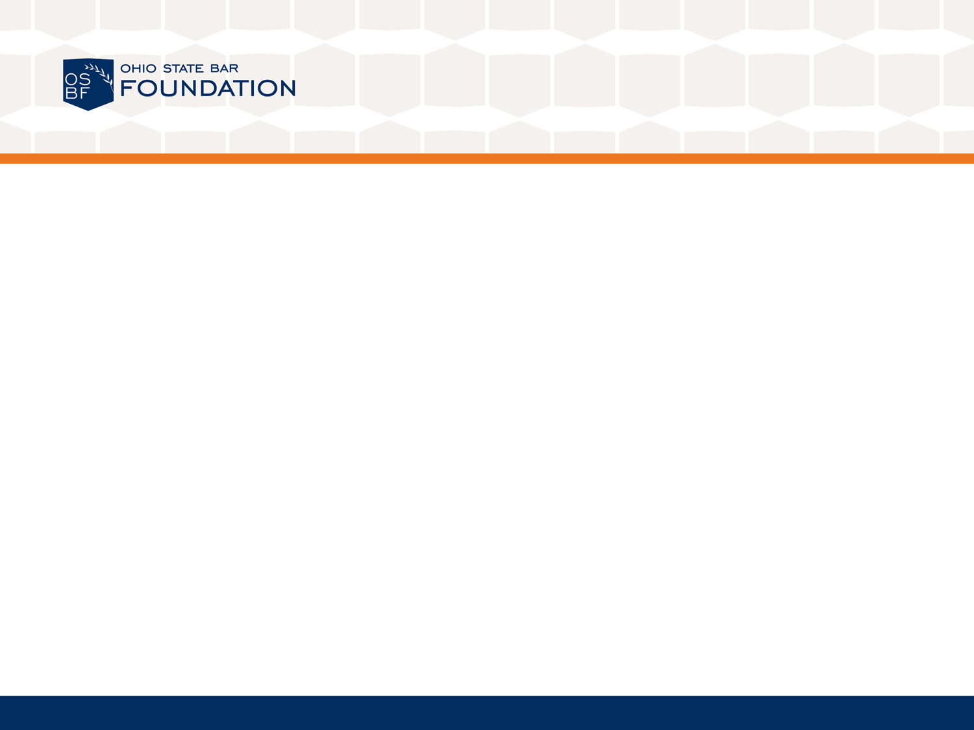

Handling Money Matters
?
Even at 18, I need a co-signer for a credit card.
Credit scores don’t include monthly payment of utility bills or rent.
All contracts have to be in writing.
As a form of identity, I should carry my social security card with me.
Checking free credit reports isn’t a productive way to see if my identity has been stolen.

Slide 3
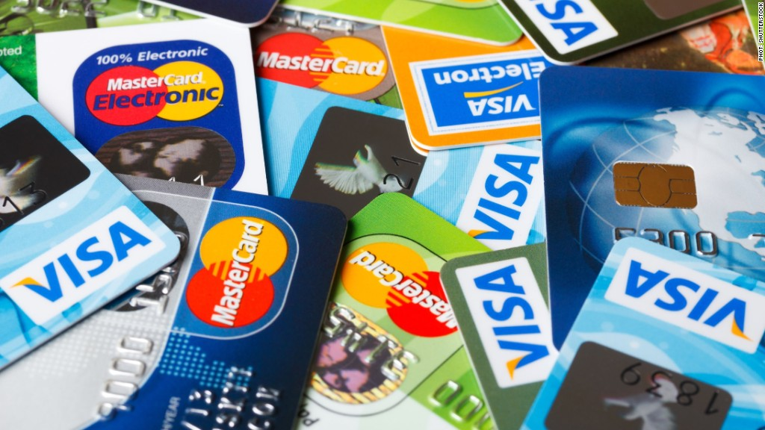
Handling Money Matters
What exactly is credit?

Slide 4

Handling Money Matters
It’s…
Buying goods or services
Paying for them later

Slide 5

Handling Money Matters
How do I get a credit card and how do I use it?

Slide 6
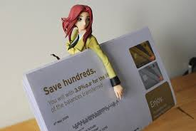


Handling Money Matters
Will be offers in the mail and at stores
Understand the offer before signing up
Shop for the best interest rate and terms

Slide 7
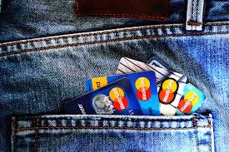

Handling Money Matters
Limit your number of credit cards
Don’t charge more than you can handle
Don’t make
Don’t make monthly minimum payments

Slide 8

Handling Money Matters
What happens if I get behind on my payments or stop paying on my credit cards?

Slide 9

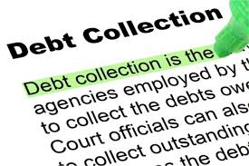
Handling Money Matters
Pay continual interest on what you still owe
Pay late fees
Have difficulty in getting more credit
Turn charges over to debt collector

Slide 10
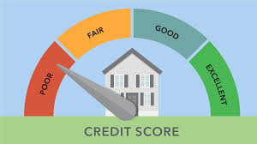
Handling Money Matters
What is a credit score?

Slide 11
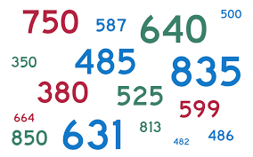
Handling Money Matters
Predetermined number
Summary of what you owe

Slide 12
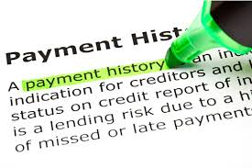
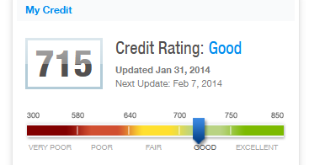
Handling Money Matters
History of your payments
High score = good credit

Slide 13
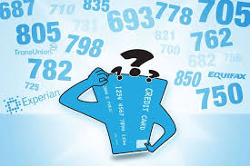
Handling Money Matters
How can I find out what my credit score is?

Slide 14



Handling Money Matters
Three major credit agencies
AnnualCreditReport.com

Slide 15

Handling Money Matters
Can I improve a bad credit score?

Slide 16
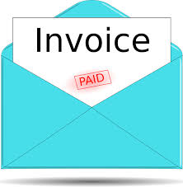
Handling Money Matters
Yes, but it won’t happen overnight...
Pay your bills on time

Slide 17


Handling Money Matters
Pay off debt
Acquire no new debt

Slide 18


Handling Money Matters
Get a steady income

Slide 19


Handling Money Matters
Stick to a monthly budget
Live within your means

Slide 20
Handling Money Matters
What is a contract?

Slide 21

Handling Money Matters
A legally binding agreement between two or more people that benefits all of them in some way

Slide 22
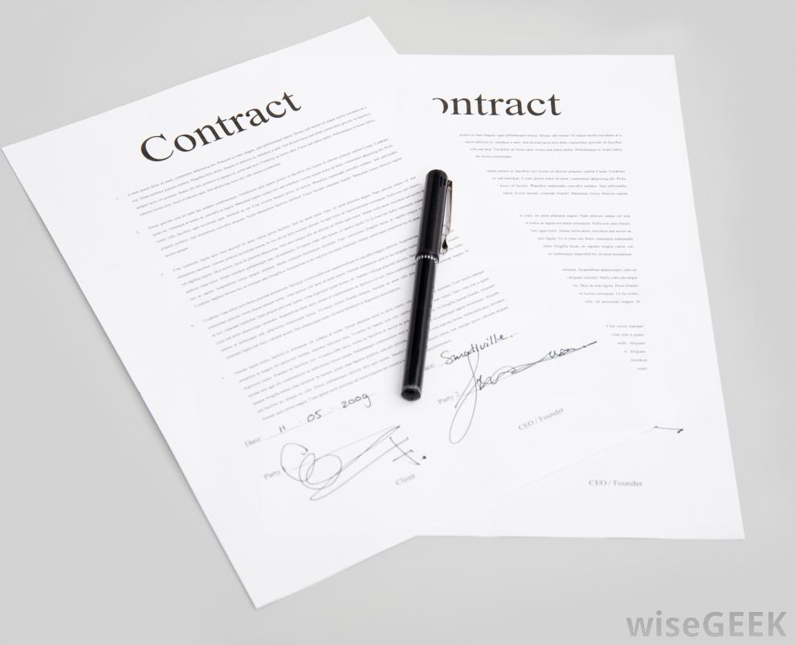
Handling Money Matters
Does a contract have to be in writing?

Slide 23

Handling Money Matters
No...
Oral contracts exist also
Written contracts are easier to enforce

Slide 24
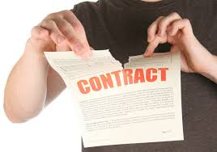
Handling Money Matters
Can I be in trouble if I break a contract?

Slide 25

Handling Money Matters
Yes...
Could be sued
Have to appear in court
Pay the judgment against you

Slide 26

Handling Money Matters
So I am ready to sign. What should I do?

Slide 27

Handling Money Matters
Read everything (fine print included)
Understand every detail (ask questions)
Change terms if you don’t agree

Slide 28

Handling Money Matters
Cross out or fill in all blank spaces
Get a signed copy

Slide 29

Handling Money Matters
Don’t be pressured to sign

Slide 30
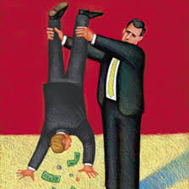
Handling Money Matters
As a consumer, am I protected in any way when others cheat me in a deal or are dishonest?

Slide 31


Handling Money Matters
Absolutely (State and federal laws)...
Ohio Attorney General’s Consumer
Protection Service
Federal Trade Commission’s Consumer
Response Center

Slide 32

Handling Money Matters
What should I learn before opening a bank account?

Slide 33

Handling Money Matters
Interest rate, fees and services
Need to maintain minimum balance

Slide 34

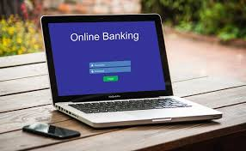
Handling Money Matters
Availability of online banking/overdraft protection

Slide 35
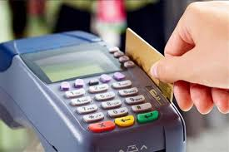
Handling Money Matters
Difference between ATM card and debit
card (fees)
Bank’s response to bounce check
Your response to lost cards or checks

Slide 36
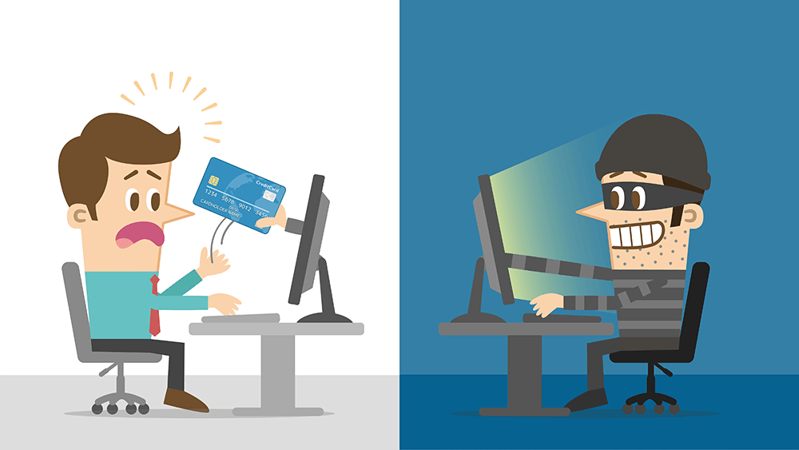
Handling Money Matters
What should I know about identity theft now that my name is going to be on credit cards,contracts, and bank accounts?

Slide 37

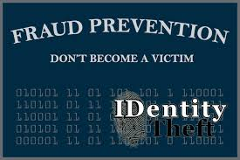
Handling Money Matters
Serious crime
Millions become victims every year
Costs billions of dollars
Pain to get identity back

Slide 38

Handling Money Matters
How can others steal my identity?

Slide 39

Handling Money Matters
Thieves try to gain personal information
Thieves rummage through trash, steal from
mail boxes or wallets, skim encoded data

Slide 40
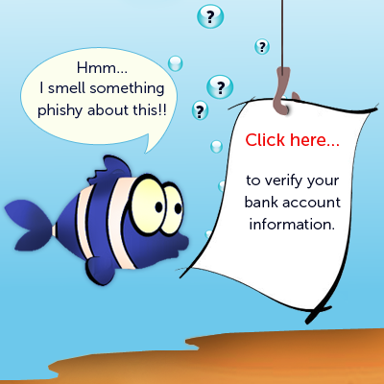
Handling Money Matters
Thieves “phish” online

Slide 41
Handling Money Matters
So how do I protect myself?

Slide 42
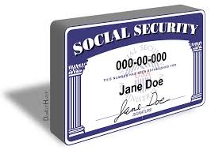
Handling Money Matters
Don’t carry your SSN with you
Shred personal information

Slide 43

Handling Money Matters
Don’t do anything sensitive on public Wi-Fi

Slide 44

Handling Money Matters
Check bills and bank statements
Check free credit reports
Don’t take the bait

Slide 45


Handling Money Matters
Verify source request as legit

Slide 46

Handling Money Matters
Click with caution when shopping online

Slide 47

Handling Money Matters
Protect personal information on computer

Slide 48

Handling Money Matters
What should I do if I think my identity has
been compromised?

Slide 49


Handling Money Matters
File a report immediately with authorities
Contact Ohio Attorney General’s Identity Theft Unit
Visit www. IdentifyTheft.gov

Slide 50
Handling Money Matters
Even at 18, I need a co-signer for a credit card. | False
Credit scores don’t include monthly payment of utility bills or rent. | False
All contracts have to be in writing. | False
As a form of identity, I should carry my social security card with me. | False
Checking free credit reports isn’t a productive way to see if my identity has been stolen. | False

