Slide 1
THREE BRANCHES OF GOVERNMENT
A CONSTITUTIONAL BLUEPRINT

Slide 2
Three Branches of Government
Division of Labor Means Division of Power

Slide 3
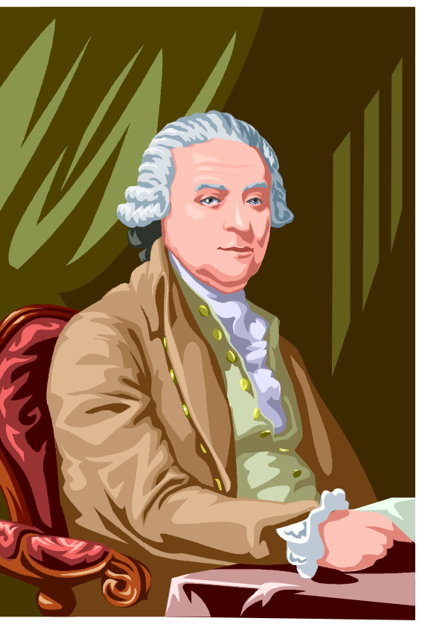
Background Story
John Adams Influence
  Limit government powers
  Separate powers
  Protect individual rights
  Do not let government violate or abuse
Adams

Slide 4
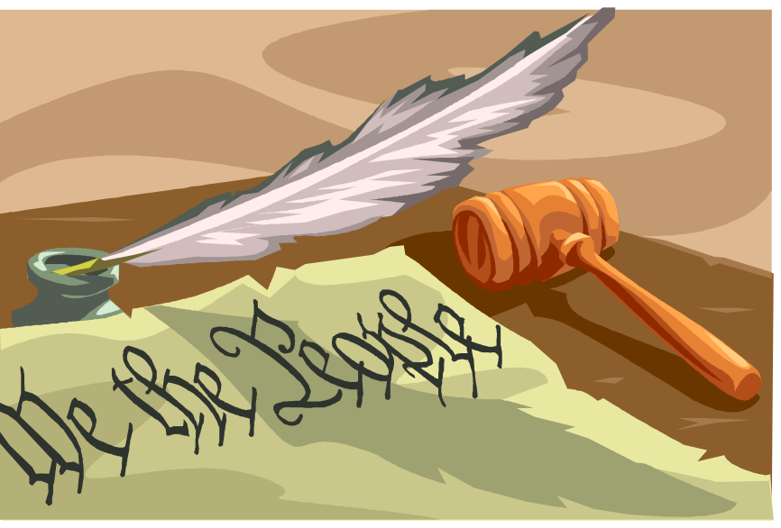
Background Story
  Wrote Constitution of Massachusetts
  Used as model for U.S. Constitution
  Described three branches of government in opening three articles

Slide 5
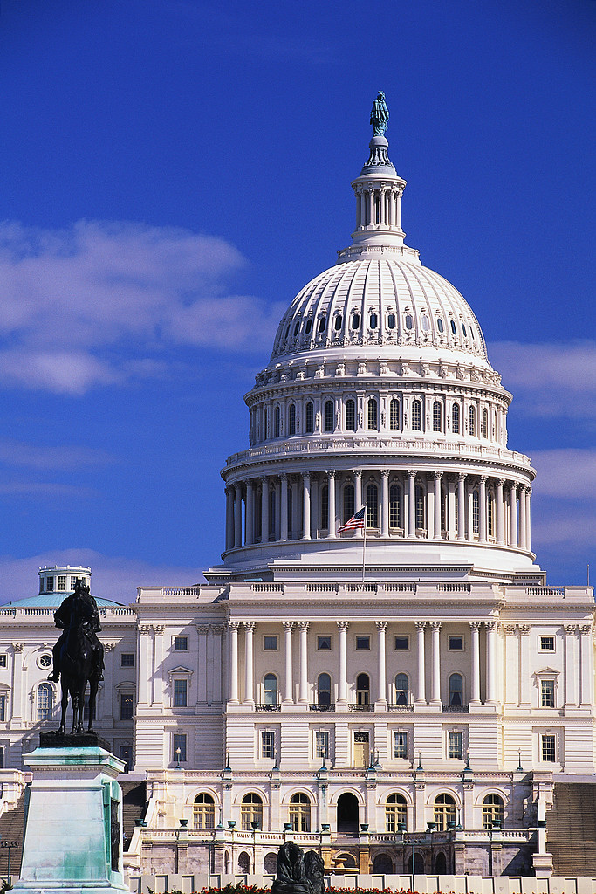
Background Story
The Legislative Branch makes laws
The Executive Branch carries out the laws
The Judicial Branch interprets the laws

Slide 6
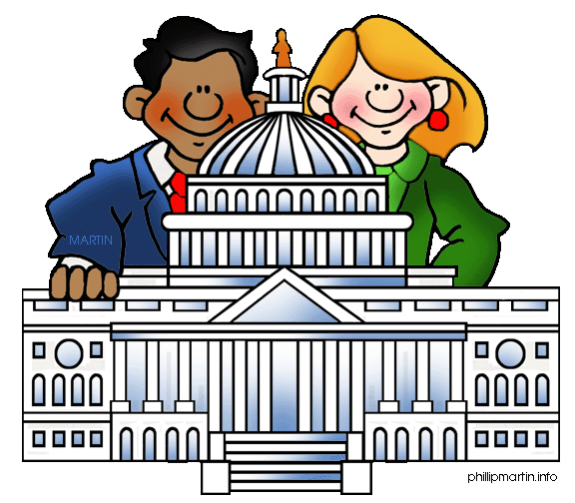
Legislative Branch- The Senate and House of Representatives
Controls purse strings
Approves budget
Oversees commerce (trade and business)

Slide 7
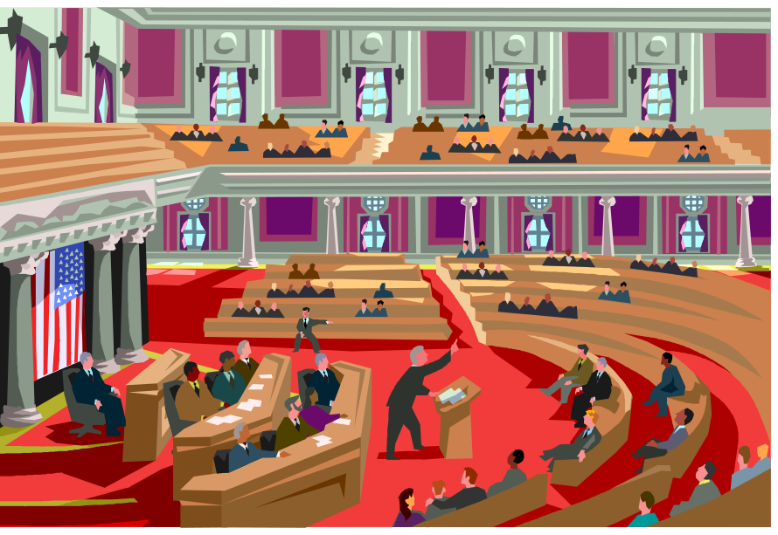
Legislative Branch- The Senate and House of Representatives
Can declare war
Can impeach
Writes, debates, passes bills into law

Slide 8
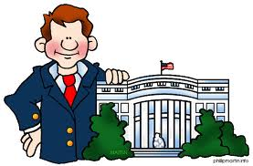
Executive Branch
Makes treaties
Appoints judges
Is Commander-in-Chief

Slide 9
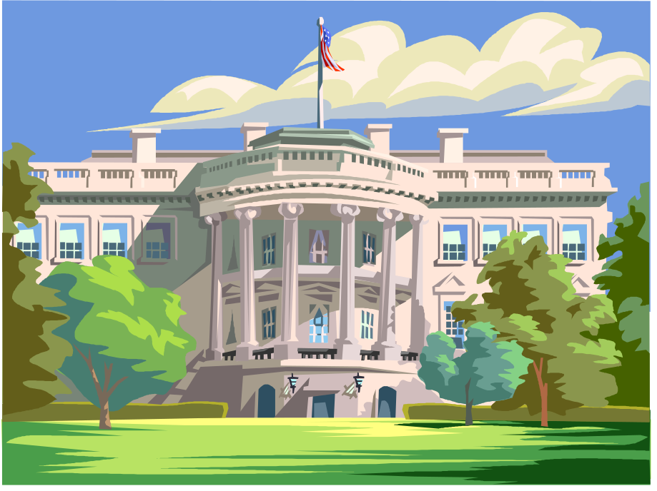
Executive Branch
Suggests budget ideas
Can veto a bill
Enforces this country’s laws

Slide 10
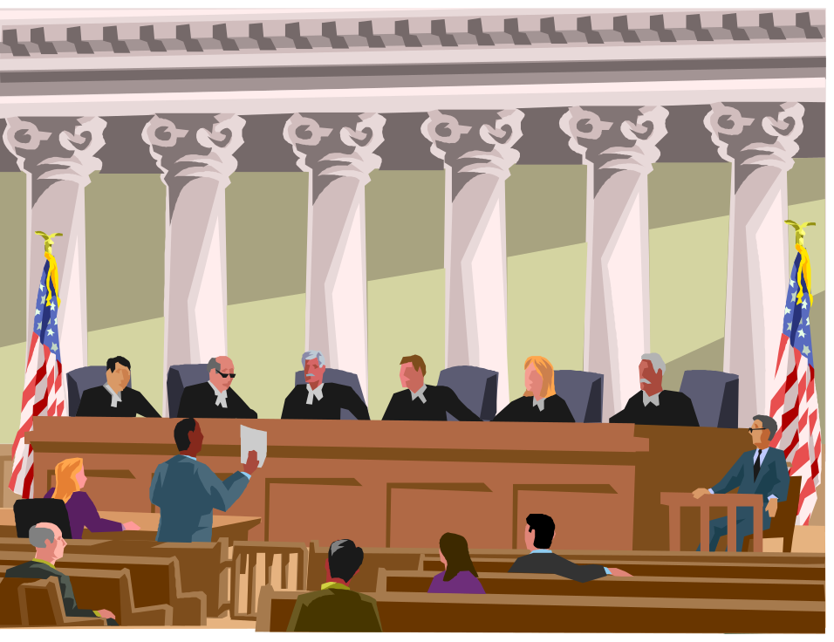
Judicial Branch
Decides arguments about the meaning of laws
Rules on how a law should be applied

Slide 11
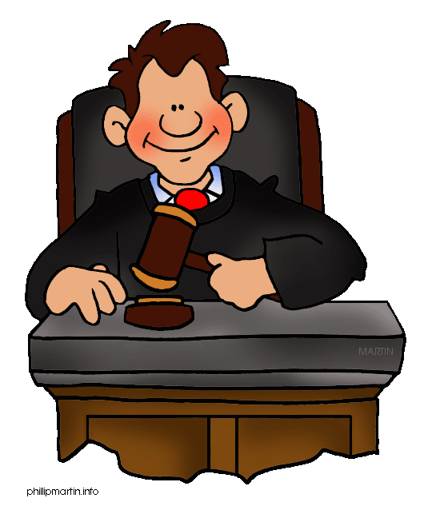
Judicial Branch
Decides when constitution is violated
Decides outcome when executive and legislative branch disagree about laws that have been passed

Slide 12
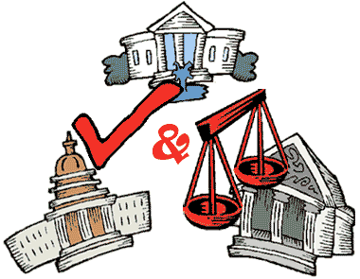
Outcome of Division of Labor
A form of job sharing
A check of powers
A balance of responsibilities
A prevention of dangerous power grabs by those who govern

Slide 13

Checks and Balances:
Legislative Check of Executive
Can override presidential vetoes
Has power of the purse strings
Can impeach president
Approves treaties and presidential appointments

Slide 14

Checks and Balances:
Legislative Check of Judicial
Creates lower courts
Can impeach judges
Approves appointments of judges

Slide 15

Checks and Balances:
Executive Check of Legislative
Veto legislation
Call special sessions of Congress
Recommend legislation
Can appeal to the people concerning legislation

Slide 16

Checks and Balances:
Executive Check of Judicial
Appoints Supreme Court judges
Appoints federal judges

Slide 17

Checks and Balances:
Judicial Check of Executive
Free from controls of executive once appointed
Can judge the constitutionality of executive actions

Slide 18

Checks and Balances:
Judicial Check of Legislative
Can judge legislative acts to be unconstitutional

Slide 19
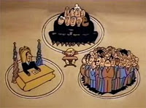
Additional Resources
Three Ring Government – Schoolhouse Rock

Slide 20
THREE BRANCHES OF GOVERNMENT
A CONSTITUTIONAL BLUEPRINT

Slide 21

Bill Me For My Idea - Making Laws
A Constitutional Blueprint

Slide 22
Background Story
U.S. Congress met for first time on March 4, 1789
Set up rules and procedures
Determined the roles of its officers- Speaker of the House and President of the Senate

Slide 23

Background Story
First law passed- Oath of Office
Created Departments of State, War, Treasury, and temporary post office
Established a federal judiciary

Slide 24


Background Story
Provided for lighthouses and expenses to negotiate with Native American tribes
Failed to locate a capital

Slide 25

Background Story
Congressmen paid $6 a day for their work
During the 1790s one-third of the Senate resigned- too much of a hardship

Slide 26
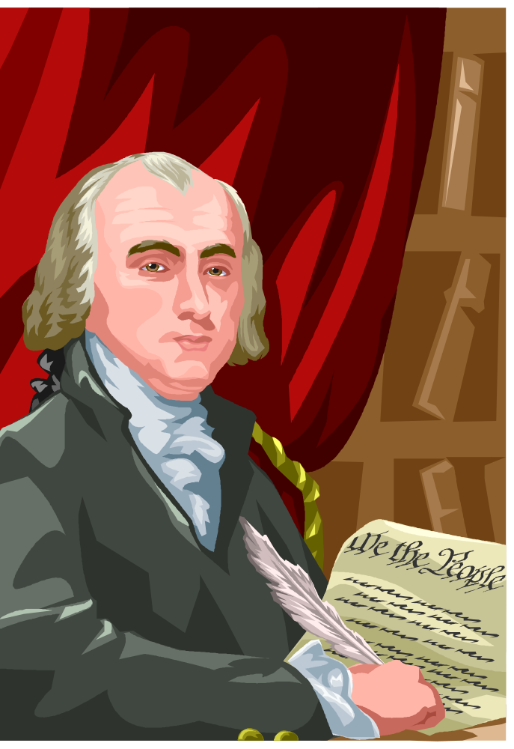
Background Story
“Scarcely a day passes without some striking evidence of the delays and perplexities springing merely from the want of precedent.”
-James Madison
A system where anyone’s idea can become law eventually evolved.
Madison

Slide 27
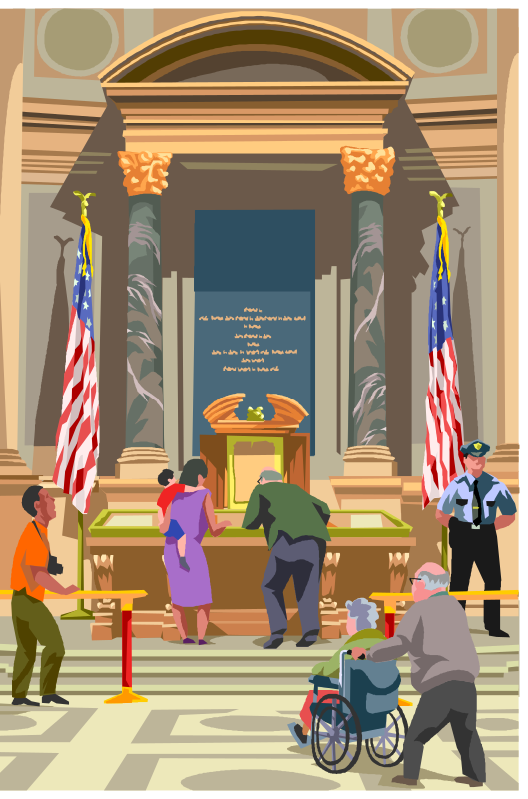
Steps in Making a Law
Start with an idea
Introduce the idea as a bill
  Write up and sponsor
  Place in hopper
  Assign a number

Slide 28

Steps in Making a Law
Goes to an appropriate committee for study
Is sent to full house or senate
Is voted on
  Viva Voce
  Division
  Recorded

Slide 29
Steps in Making a Law
Goes through same procedure in other chamber
Goes to a conference committee if differences exist

Slide 30


Steps in Making a Law
Once delivered to president, the bill
  Is signed
  Is vetoed (Sent back to Congress where it needs a 2/3 majority vote to override veto)
  Becomes law without his signature (pocket veto)

Slide 31

Steps in Making a Law
Becomes a law
    Once president signs
    When president uses a pocket veto
    When Congress overrides a veto

Slide 32
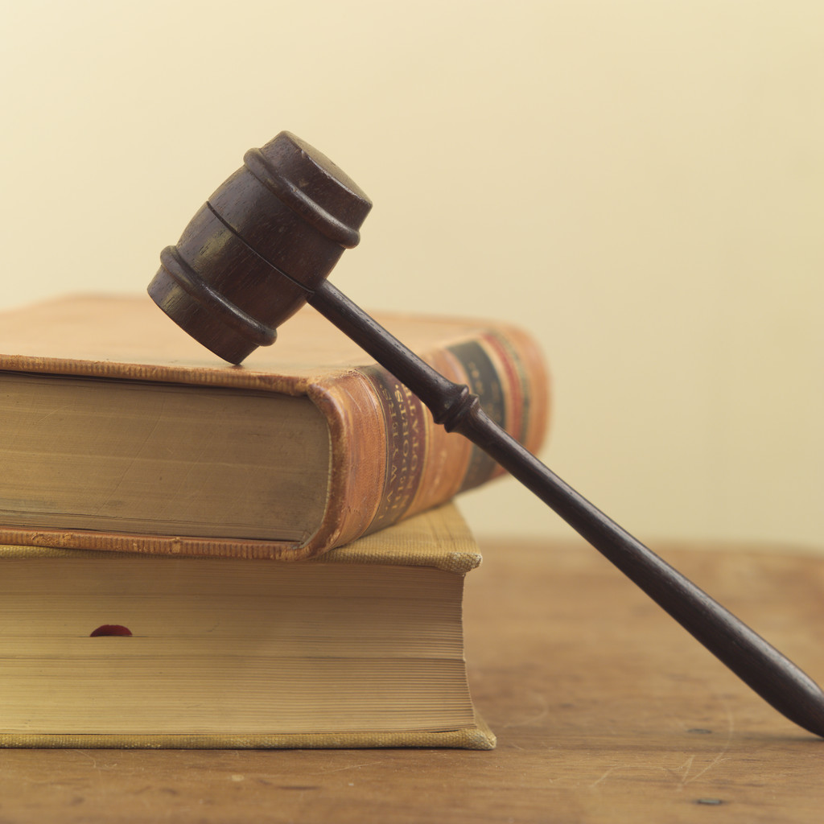
Outcome
Congress has passed more than 20,000 laws
200-600 have been passed during each of its 112 two-year sessions
House may debate and vote on a bill in a single day- Senate may take longer

Slide 33

Outcome
House set up to represent closely the will of the people:
  Re-election every two years
  Represents smaller group of people
  Often votes on a bill because of its impact on district

Slide 34

Outcome
Senate set up to look at long term effects
  Re-election every six years
  Represents an entire state
  Often votes based on the interests of an entire nation

Slide 35
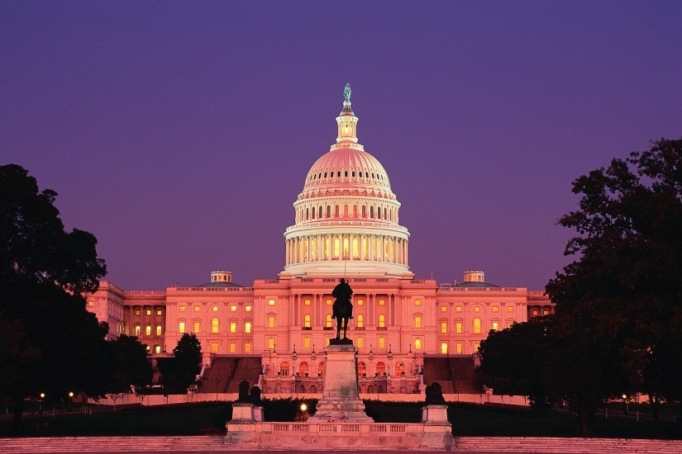
Outcome
Debate and compromise are at the heart of bills becoming laws
Two unique chambers, the House and the Senate, are another form of “checks and balances”

Slide 36
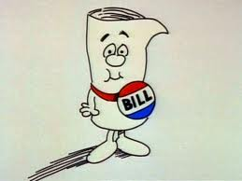
Additional Resources
Just A Bill – Schoolhouse Rock

Slide 37
THREE BRANCHES OF GOVERNMENT
A CONSTITUTIONAL BLUEPRINT

Slide 38
The Fourth Branch - You the Voter
A Constitutional Blueprint

Slide 39
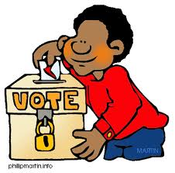
Background Story
Voting is not explicitly guaranteed
Constitution only describes how to elect
Constitution does ban discrimination

Slide 40

Background Story
States and local governments control basic voting rights
Over 13,000 jurisdictions
Only free, white males used to vote

Slide 41
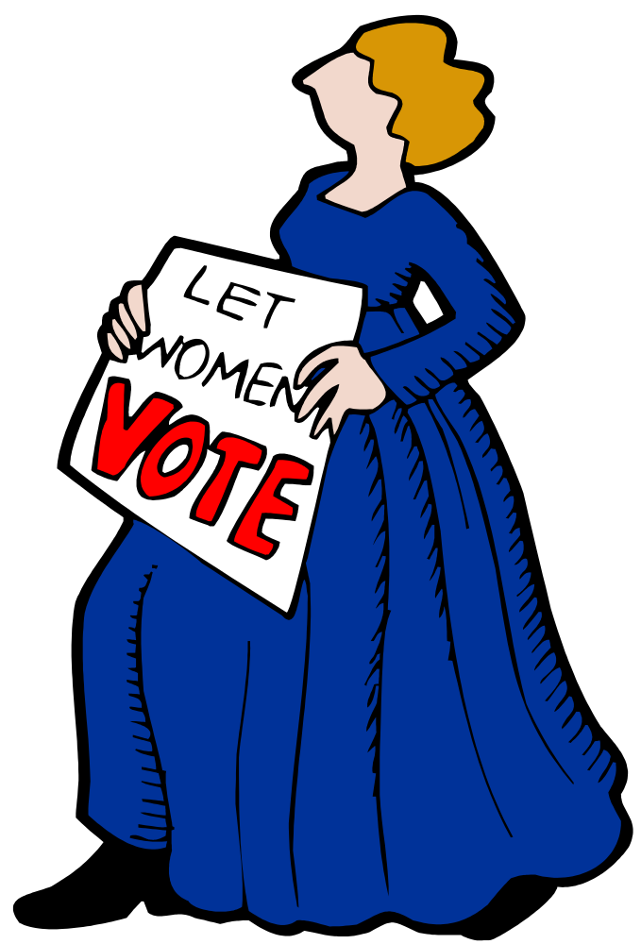
Background Story
Women got the right to vote in 1920 – 19th Amendment
Any citizen over 18 can now vote – 26th Amendment
States determine how one votes

Slide 42
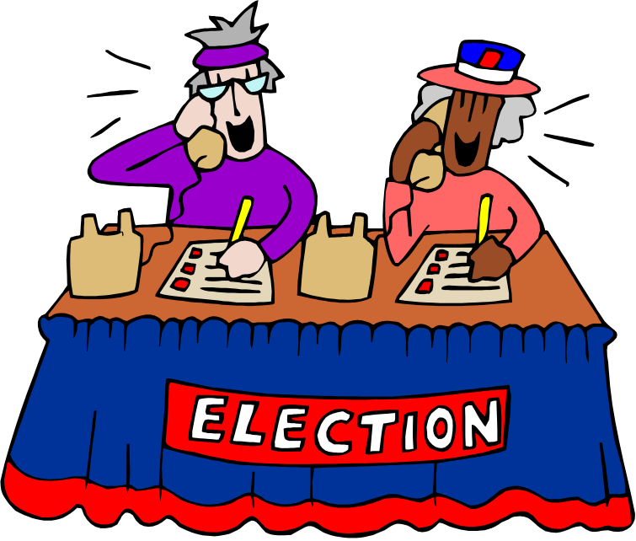
Background Story
In 2000 only 51% voted
Gore would have won in 2000 with a change of only 279 votes in Florida
Voting makes a difference- Texas statehood determined by only one vote

Slide 43

Background Story
Amendments make a difference:
  African-Americans (15th Amendment)
  Women (19th Amendment)
  18-year-olds (26th Amendment)

Slide 44

Background Story
You can campaign, volunteer, register voters, and state your opinion even if you are not old enough to vote

Slide 45

Outcome
Voting is essential to democracy
The “Fourth Branch” (voters) determines whether the other three branches work

Slide 46

Outcome
Voters give consent to be governed
Voters have the right (referendum) to repeal laws
Voters are the ultimate power in checks and balance system

Slide 47
THREE BRANCHES OF GOVERNMENT
A CONSTITUTIONAL BLUEPRINT

Slide 48
Separation of Powers
Relevant Case
United States v. Nixon (1974)

Slide 49

Background Story
Separation of Powers was challenged in 1972
Five men illegally broke into Democratic National Headquarters (Watergate complex)
Men were connected to Nixon’s re-election committee

Slide 50

Background Story
Nixon and staff covered up the break-in (also an illegal act)
Senate Watergate Committee conducted hearings

Slide 51

Background Story
Evidence mounted against the president
Nixon recorded conversations with his staff
Committee wanted to know if conversations tied the president to break-in and cover-up

Slide 52
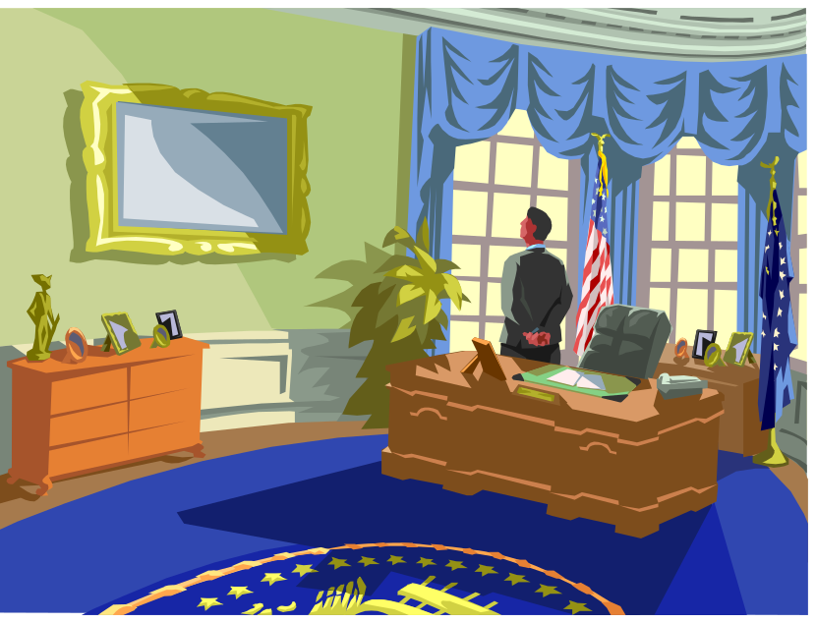
Background Story
Tapes were subpoenaed
President filed a motion against the subpoena
President claimed executive privilege
Conflict reached the Supreme Court

Slide 53

Legal Problem
Can a president, as he exercises presidential authority, keep conversations and information confidential?

Slide 54

Arguments for the Special Prosecutor
Tapes might have information about break-in and cover-up
White House tapes are only source for that information

Slide 55

Arguments for the Special Prosecutor
Executive privilege is not absolute
Scope of executive privilege should be determined by the courts, not the president
President cannot withhold information essential to a criminal investigation

Slide 56
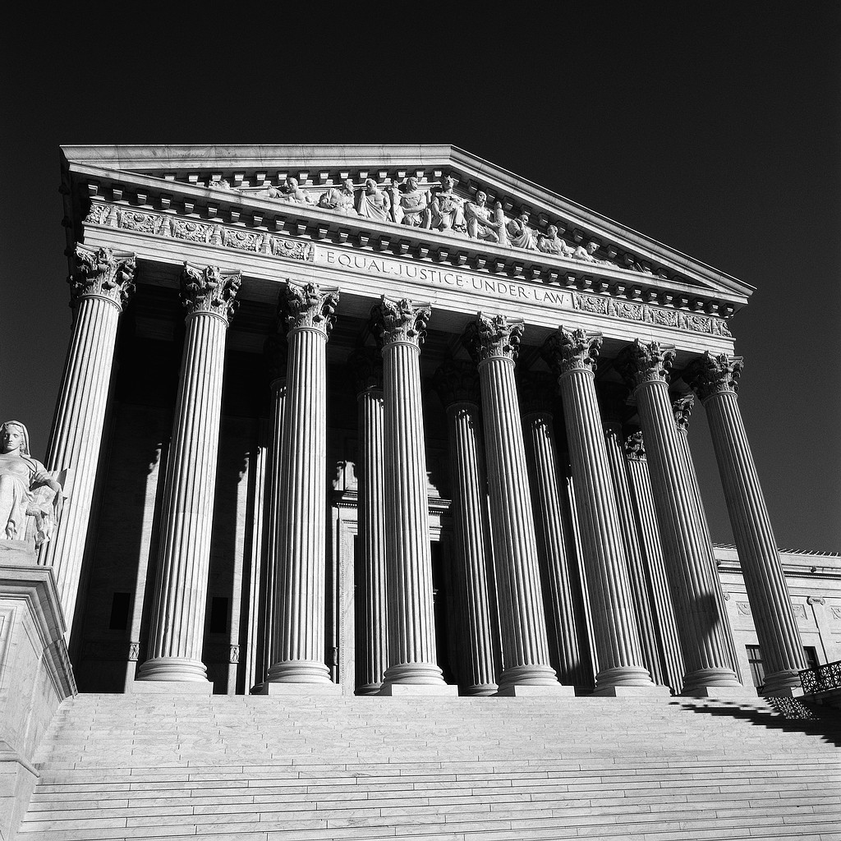
Arguments for the President
TOP SECRET
Confidential conversations are not for public view
Executive privilege is absolute under the separation of powers doctrine
Judicial Branch cannot subpoena tapes

Slide 57
Outcome
The Supreme Court (9-0) ruled that Nixon had to comply to the subpoena
Separation of powers has limits

Slide 58
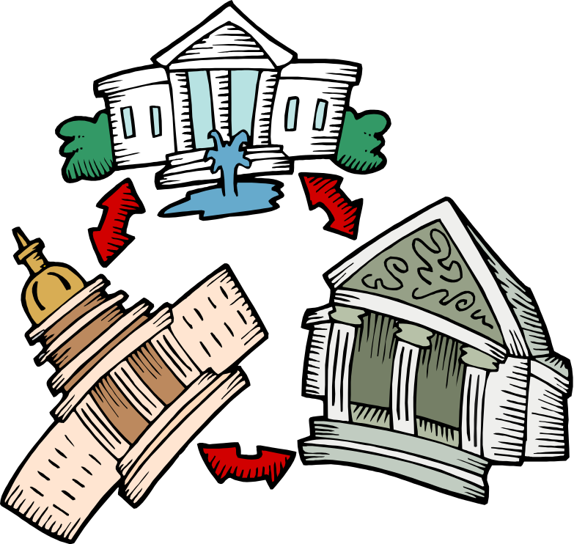
Outcome
Limits are determined by the court, not the president
Tapes’ information did not directly relate to president’s authority granted by Constitution

Slide 59
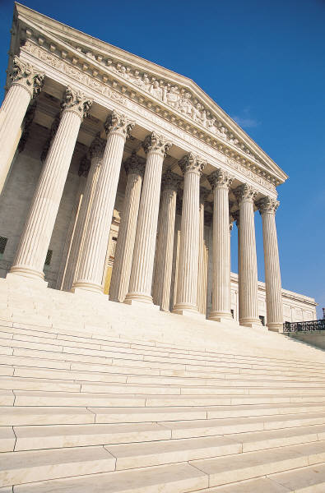
Outcome
Executive privilege can not block information relevant to a criminal prosecution
President must obey lawful court orders just like any other citizen

Slide 60
THREE BRANCHES OF GOVERNMENT
A CONSTITUTIONAL BLUEPRINT

Slide 61
Separation of Powers
Historical Case
Marbury v. Madison (1803)

Slide 62
Background Story
The Constitution was only 16 years old
A constitutional feud between outgoing President John Adams and incoming President Thomas Jefferson occurred

Slide 63
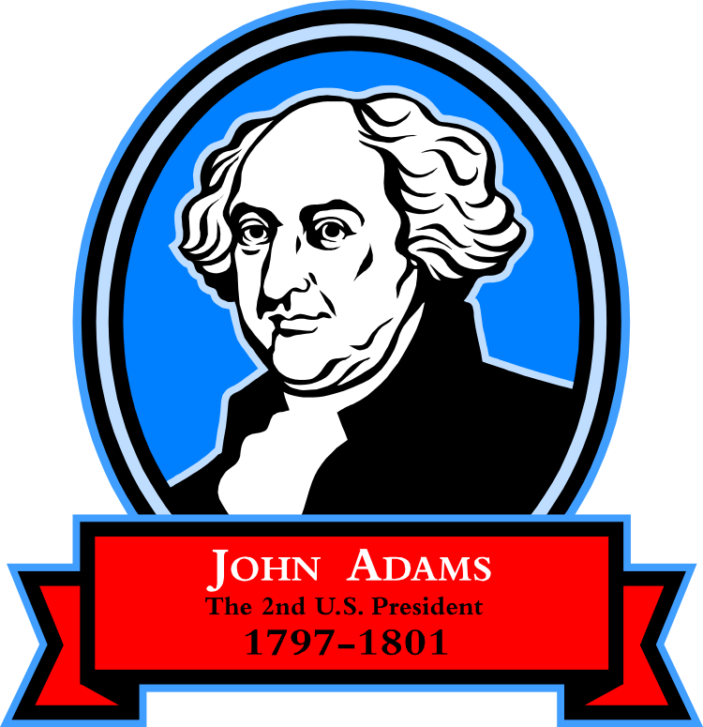
Background Story
Founding Fathers never said who had final say about constitutional issues
Lame Duck President John Adams appointed 58 people to government jobs, including William Marbury

Slide 64
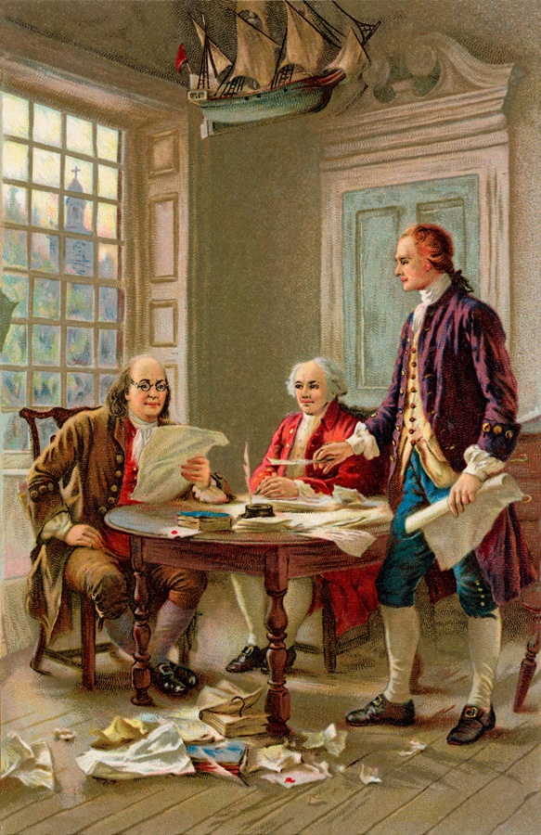
Background Story
Appointees could not start jobs without signed papers in hand from Adams
Marbury’s papers were not delivered before Jefferson took office

Slide 65
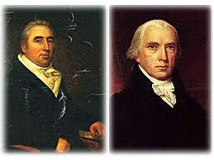
Background Story
Jefferson’s Secretary of State, James Madison, was told not to deliver papers to Marbury
Jefferson wanted to appoint someone else
Marbury Madison

Slide 66

Background Story
Marbury sued Madison
Marbury went to the Supreme Court
Marbury wanted to force Madison to deliver the paperwork

Slide 67
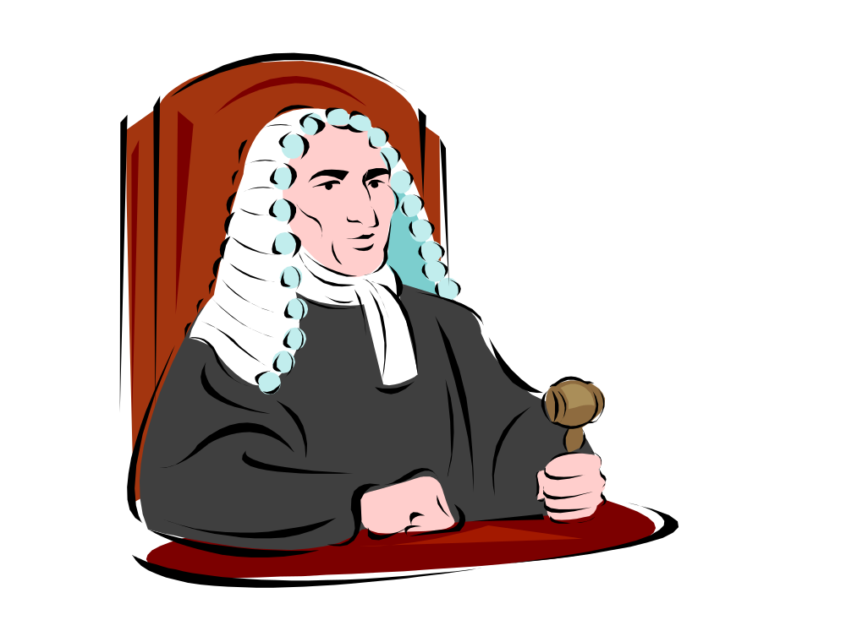
Background Story
Marbury would have already been on the job if papers had been delivered on time
Marbury thought he deserved the job

Slide 68
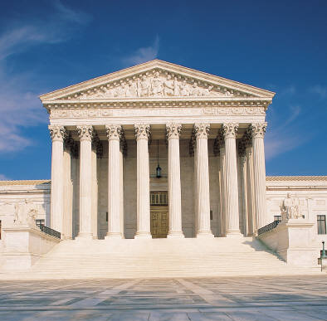
Legal Problem
Whose job was it?
Could Supreme Court order president to do something?
Who would have final say?

Slide 69
Marbury’s Arguments
He was legally appointed to the job
Jefferson could not undercut Adams
Congress’s Judiciary Act of 1789 (the establishment of a judicial system) gave the Supreme Court the power to tell another branch of government what to do

Slide 70

Madison’s Arguments
Judiciary Act did not give absolute power to the Supreme Court
Supreme Court cannot rule since the suit should not have been brought to it in the first place
The Court did not have the right to tell Jefferson what to do

Slide 71
Outcome
Marbury had the right to appointment but never got it
Court ruled the Judiciary Act of 1789 unconstitutional
Congress cannot grant powers, only the Constitution can

Slide 72
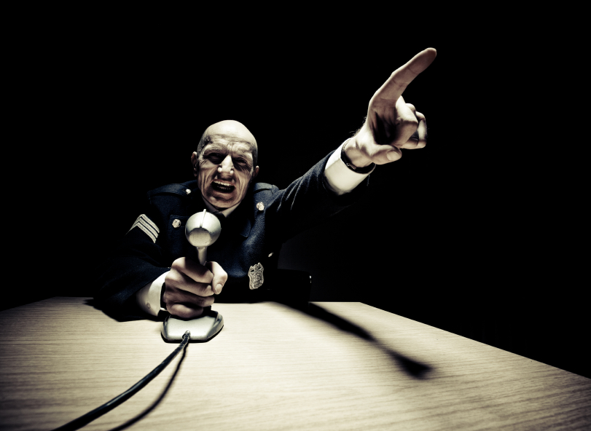
Outcome
Constitution did not give the Supreme Court these powers
Supreme Court could not force Jefferson’s hand

Slide 73
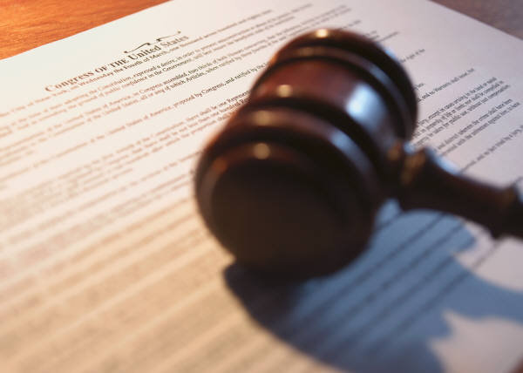
Outcome
Marbury v. Madison, however, did establish a precedent- legal decision to serve as an example in future cases
Court has the right to review congressional laws

Slide 74
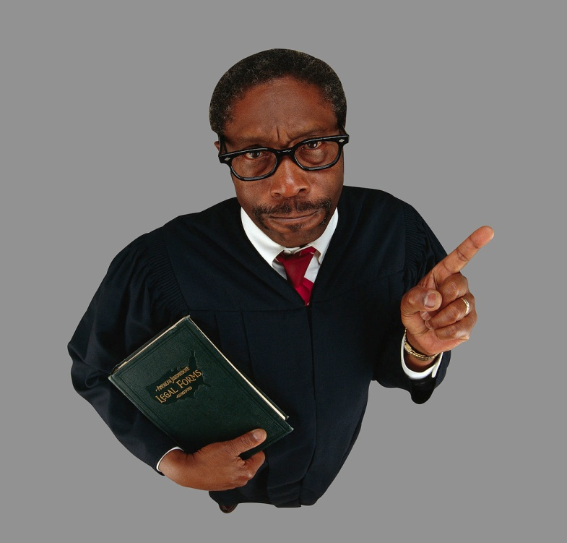
Outcome
Court has the right to review presidential acts
Judicial review is established

Slide 75
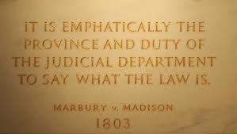
Outcome
Constitution is supreme law of the land
Supreme Court has final say over Constitution’s meaning

Slide 76
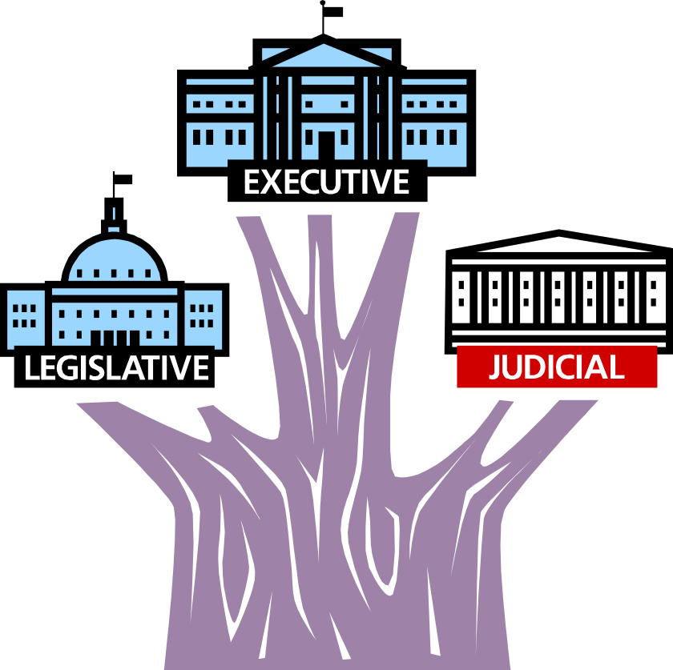
Outcome
Distinct separation of powers is defined
Neither Congress nor president can rule on Constitution
Supreme Court only can rule on constitutional meaning

Slide 77

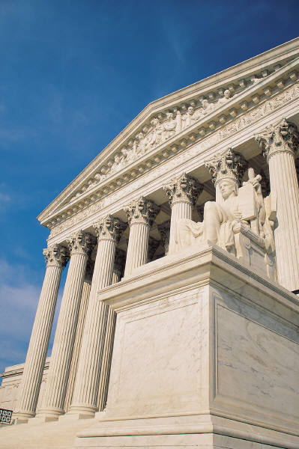
Outcome
Jefferson won the battle
Supreme Court won the war

Slide 78
THREE BRANCHES OF GOVERNMENT
A CONSTITUTIONAL BLUEPRINT

Slide 79
Do’s and Don’ts For Teens
A Trickle Down Effect

Slide 80

Background Story
One in five Americans can name all five members of Homer Simpson’s family
Only one in 1,000 can name First Amendment’s five basic freedoms

Slide 81


Background Story
One in five think First Amendment protects right to own a pet
One in 17 think it guarantees the right to drive a car

Slide 82
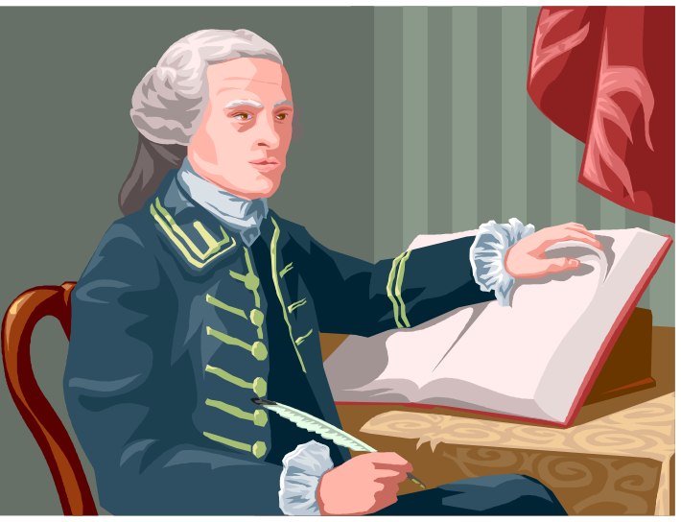
Background Story
In a trickle down way the Constitution does have a say about pet ownership and driving privileges

Slide 83
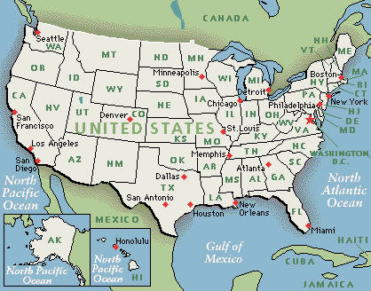
Background Story
It provides governing law for entire country
It states government responsibilities and limitations
It defines individual rights and group rights

Slide 84


Background Story
It influences everyday routines:
  Texting or talking on a cell phone
  Using computers
  Going to church, school, or the corner drugstore
  Crossing the street

Slide 85
Background Story
The Constitution establishes in an indirect way the guidelines for most of our really important activities

Slide 86

Outcome
  What laws may affect what I do and how I do it?
  What’s in it for me?

Slide 87
Areas Defined and Limited by Legislation
Curfews | Internet Usage | Teen Pregnancy | Parental Notification regarding contraceptives
Music Censorship | Minimum Wages | Tagging Vandalism Egging Spray painting | Bullying
Drug Use | Alcohol Use/Drinking Age | Sex/Dating | Teen Smoking
Work Hiring/Firing | Fighting | Shoplifting | Video Games
Movies/T.V. | Being tried as an adult-When? What for? | Loitering | Runaways
Auto Ownership Insurance | Motorcycle Riding | Driving | Legal Age to Leave Home
Staying in School/ Graduation | Teen Marriage | Sexting/Texting | Gangs

Slide 88
THREE BRANCHES OF GOVERNMENT
A CONSTITUTIONAL BLUEPRINT

Slide 89
Present Day Realities
Judging Separation of Powers
Created by the Ohio State Bar Foundation

Slide 90
Background Story
The Constitution… meant that its coordinate branches should be checks on each other. But the opinion which gives to the judges the right to decide what laws are constitutional and what not, not only for themselves in their own sphere of action but for the Legislature and Executive also in their spheres, would make the Judiciary a despotic branch.
Thomas Jefferson, 1804

Slide 91
Background Story
The Branches still clash over their powers
The Branches are balanced so that no one branch becomes too powerful
The Founding Fathers wanted us always to challenge who has the power and how it is being used

Slide 92
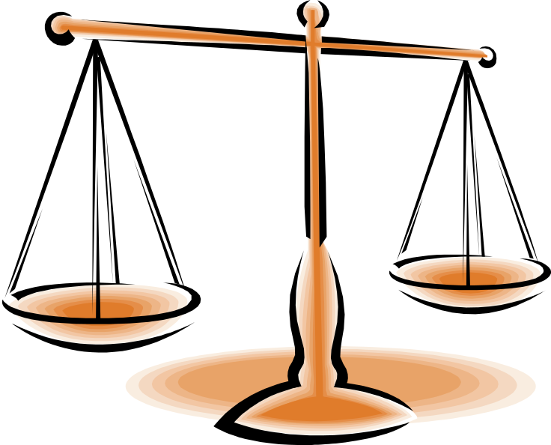
Asking Questions About the Three Branches of Government
Is it good for only the Supreme Court to decide what is constitutional?
Why is the judgment of constitutionality in the hands of the Supreme Court alone? Legislators and presidents take an oath to uphold the Constitution also.

Slide 93
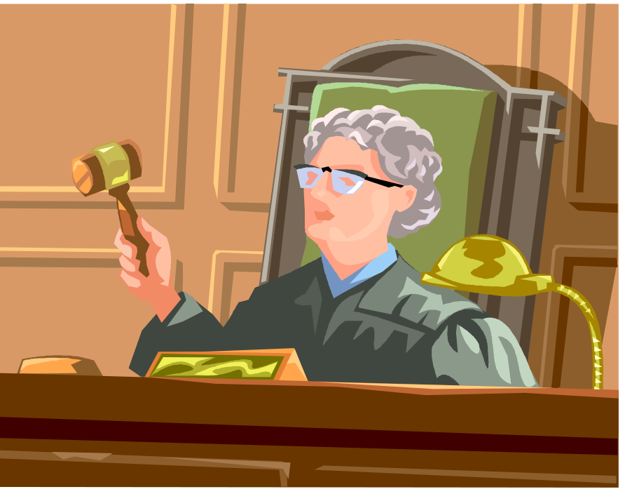
Asking Questions About the Three Branches of Government
What is an activist judge?
Is it good or bad to be one?

Slide 94

Asking Questions About the Three Branches of Government
How can the U.S. Supreme Court decide who won an election as it effectively did when it decided Bush v. Gore in 2000?

Slide 95
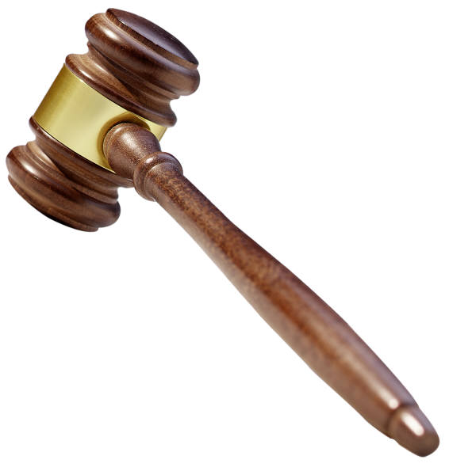
Asking Questions About the Three Branches of Government
Why can something be declared constitutional and 50 years later be declared unconstitutional?
Does the Constitution really have absolute meaning? Is there ever an absolute interpretation?

Slide 96
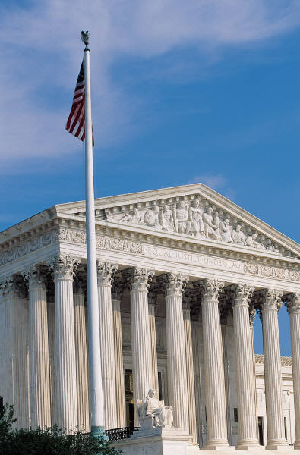
Asking Questions About the Three Branches of Government
If Congress passes a law that may be unconstitutional but is not challenged in court, don’t we have to obey it no matter what?
What could happen if the Supreme Court’s rulings are not obeyed? Has this ever happened in our history?

Slide 97
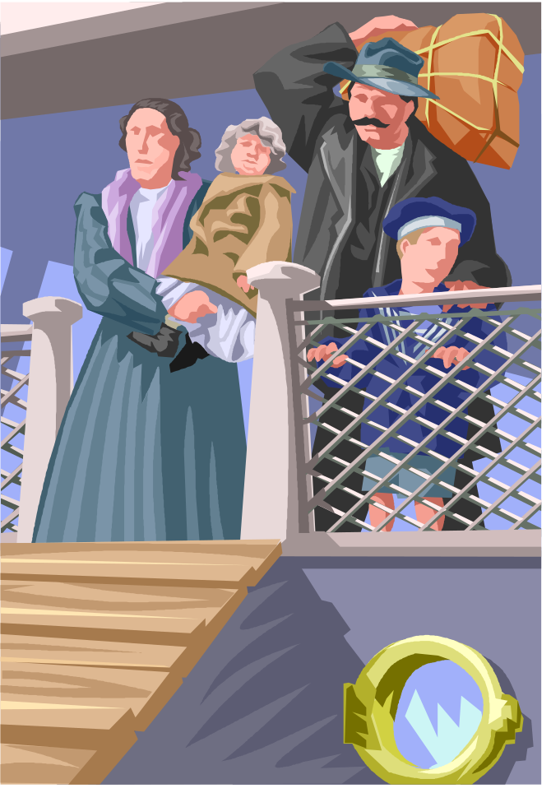
Asking Questions About the Three Branches of Government
Are there issues about which the Constitution is silent? What might some of these be? Immigration? Marriage? Education? Political parties? Age discrimination?
Who has the right to make decisions about them?

Slide 98
Asking Questions About the Three Branches of Government
Has the Executive Branch ever taken on more power than was given to it?
Can a president have more power in time of war- even a continuing war on terrorism?

Slide 99
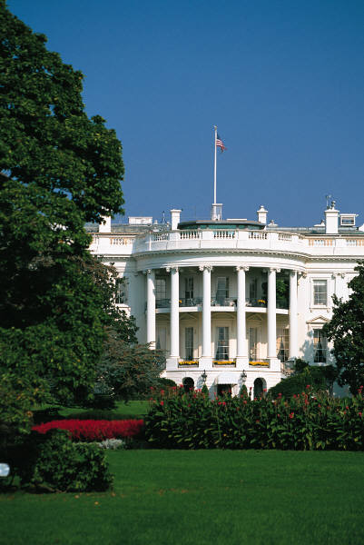
Asking Questions About the Three Branches of Government
Is our government very efficient? Aren’t checks and balances a hindrance at times?
Do politics play too much a part in running all three branches of government? Does money?

Slide 100
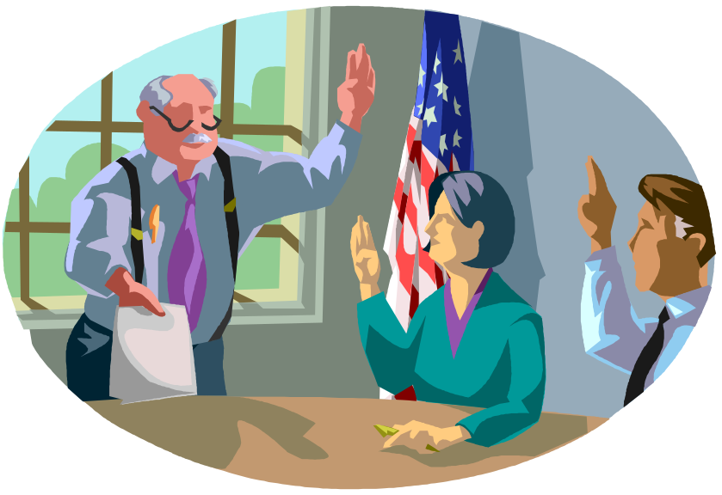
Asking Questions About the Three Branches of Government
Should a legislator vote what he thinks is right? Or, should he always vote the majority’s wishes?
How can our Constitution still be relevant today? Hasn’t the world changed too much?

Slide 101

Asking Questions About the Three Branches of Government
Can our government and our Constitution survive if only one out of two people, at best, vote?
Or, do we want only the willing to determine our future?

Slide 102

Asking Questions About the Three Branches of Government
Would you ever see yourself as an elected official? Why or why not?

