Slide 1



PRESENTS

Slide 2
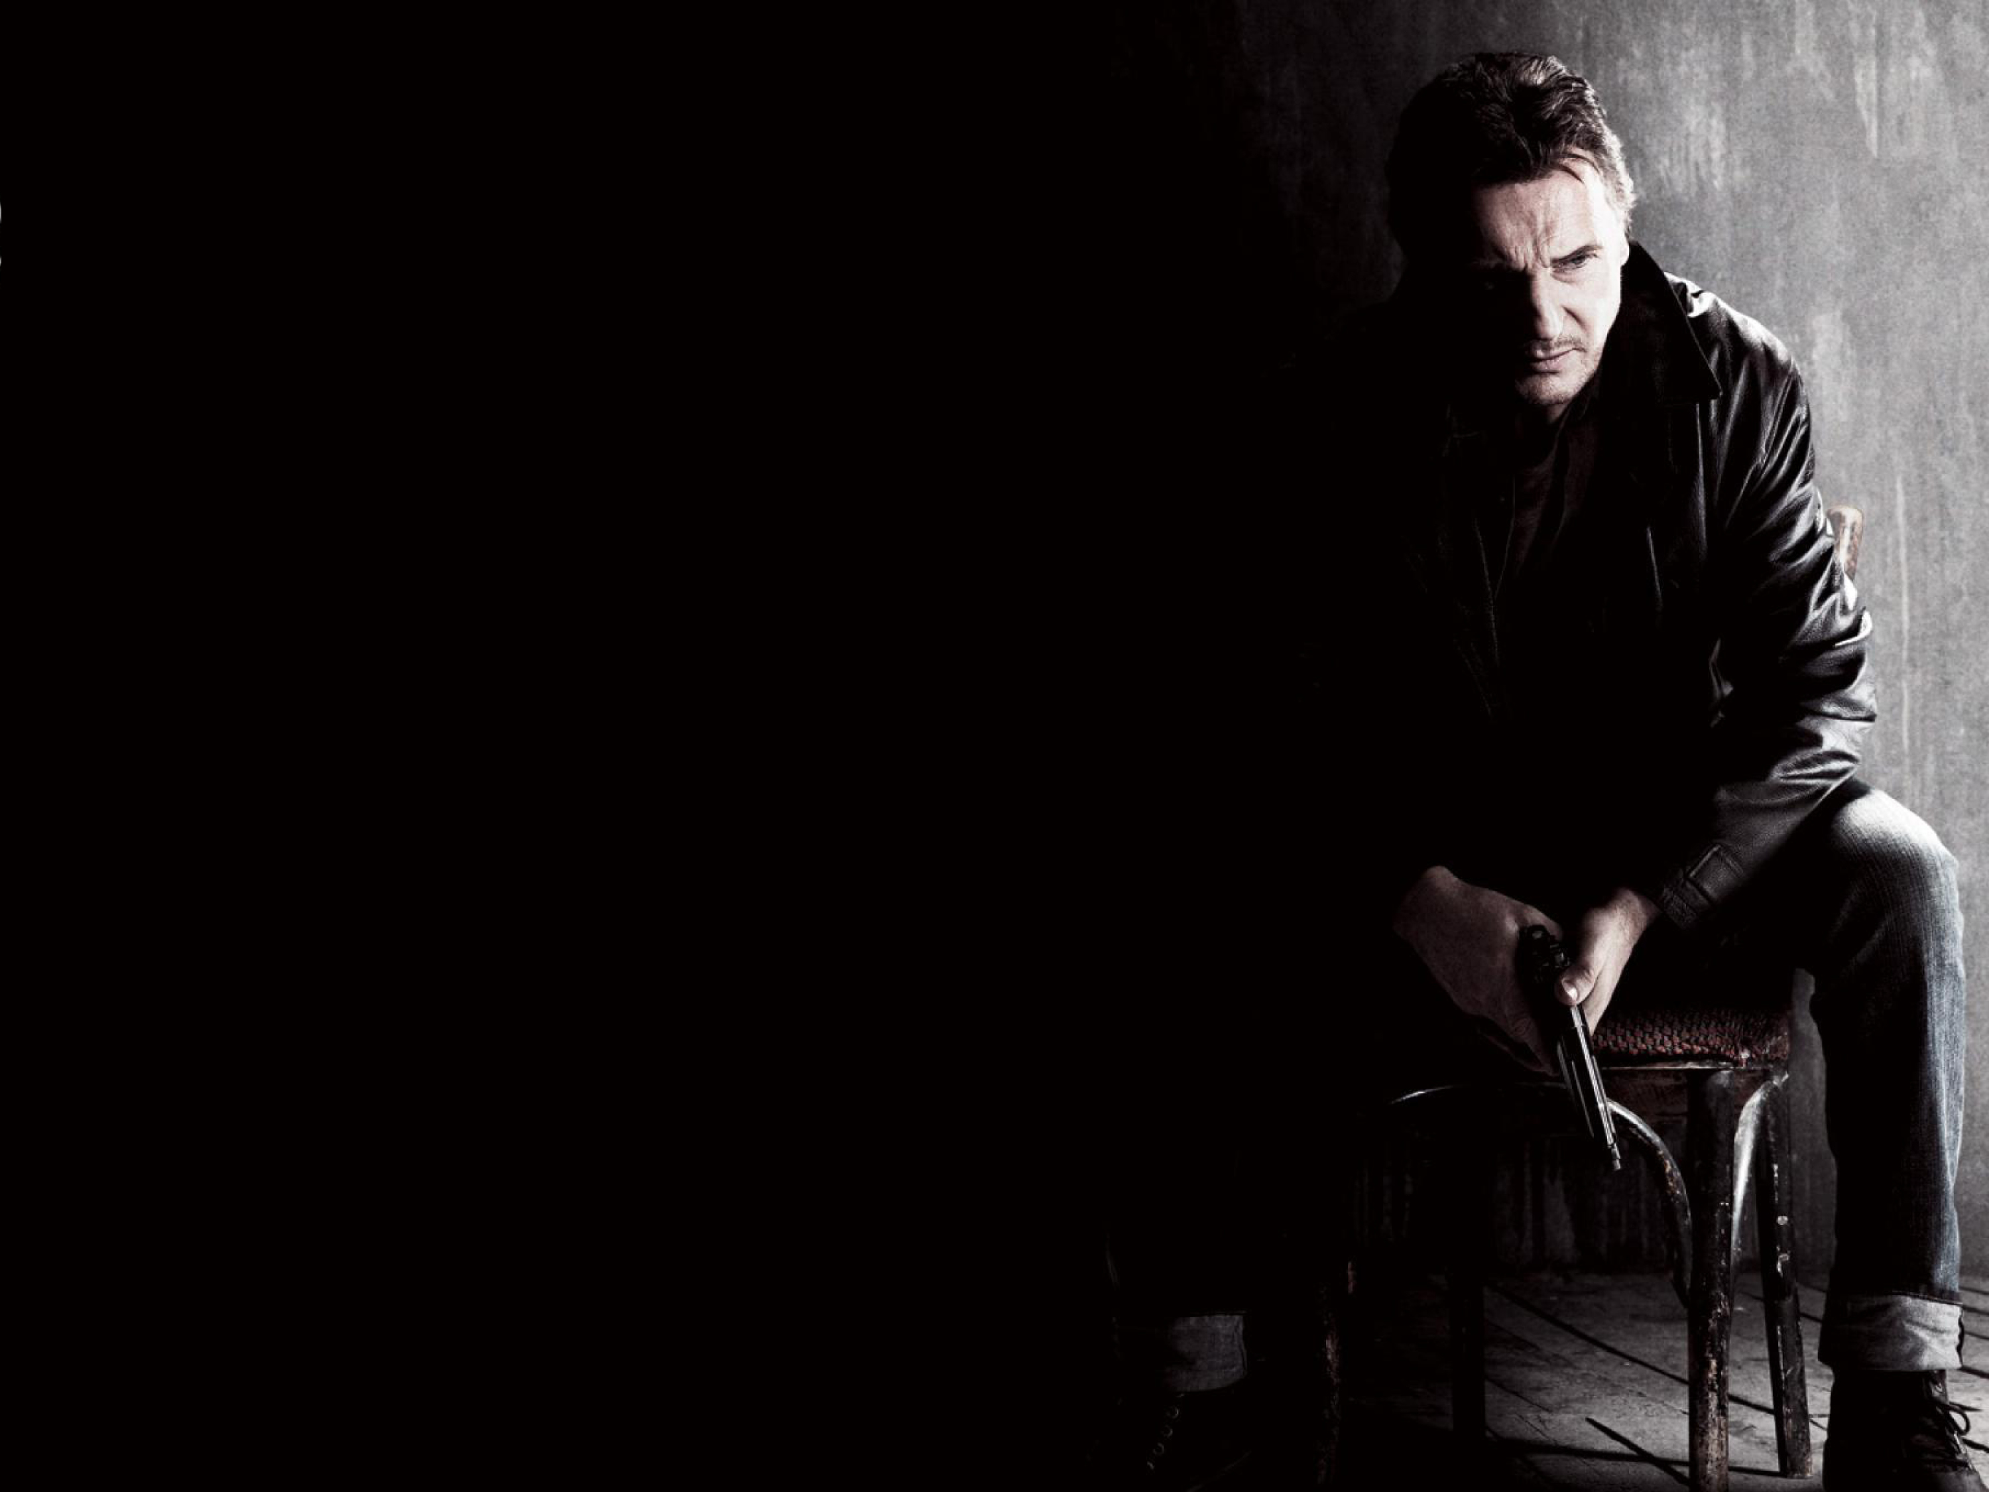
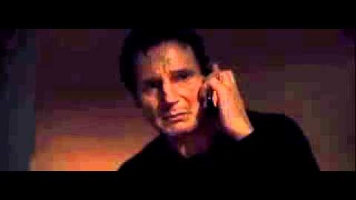
Successful movie franchise since 2009
Sex trafficking ring of young,
virgin American girls
Protagonist is white male played
by Liam Neeson
One of the most quoted
monologues of all time

Slide 3

OHIO is the fourth worst
state in the nation
for human trafficking

Slide 4
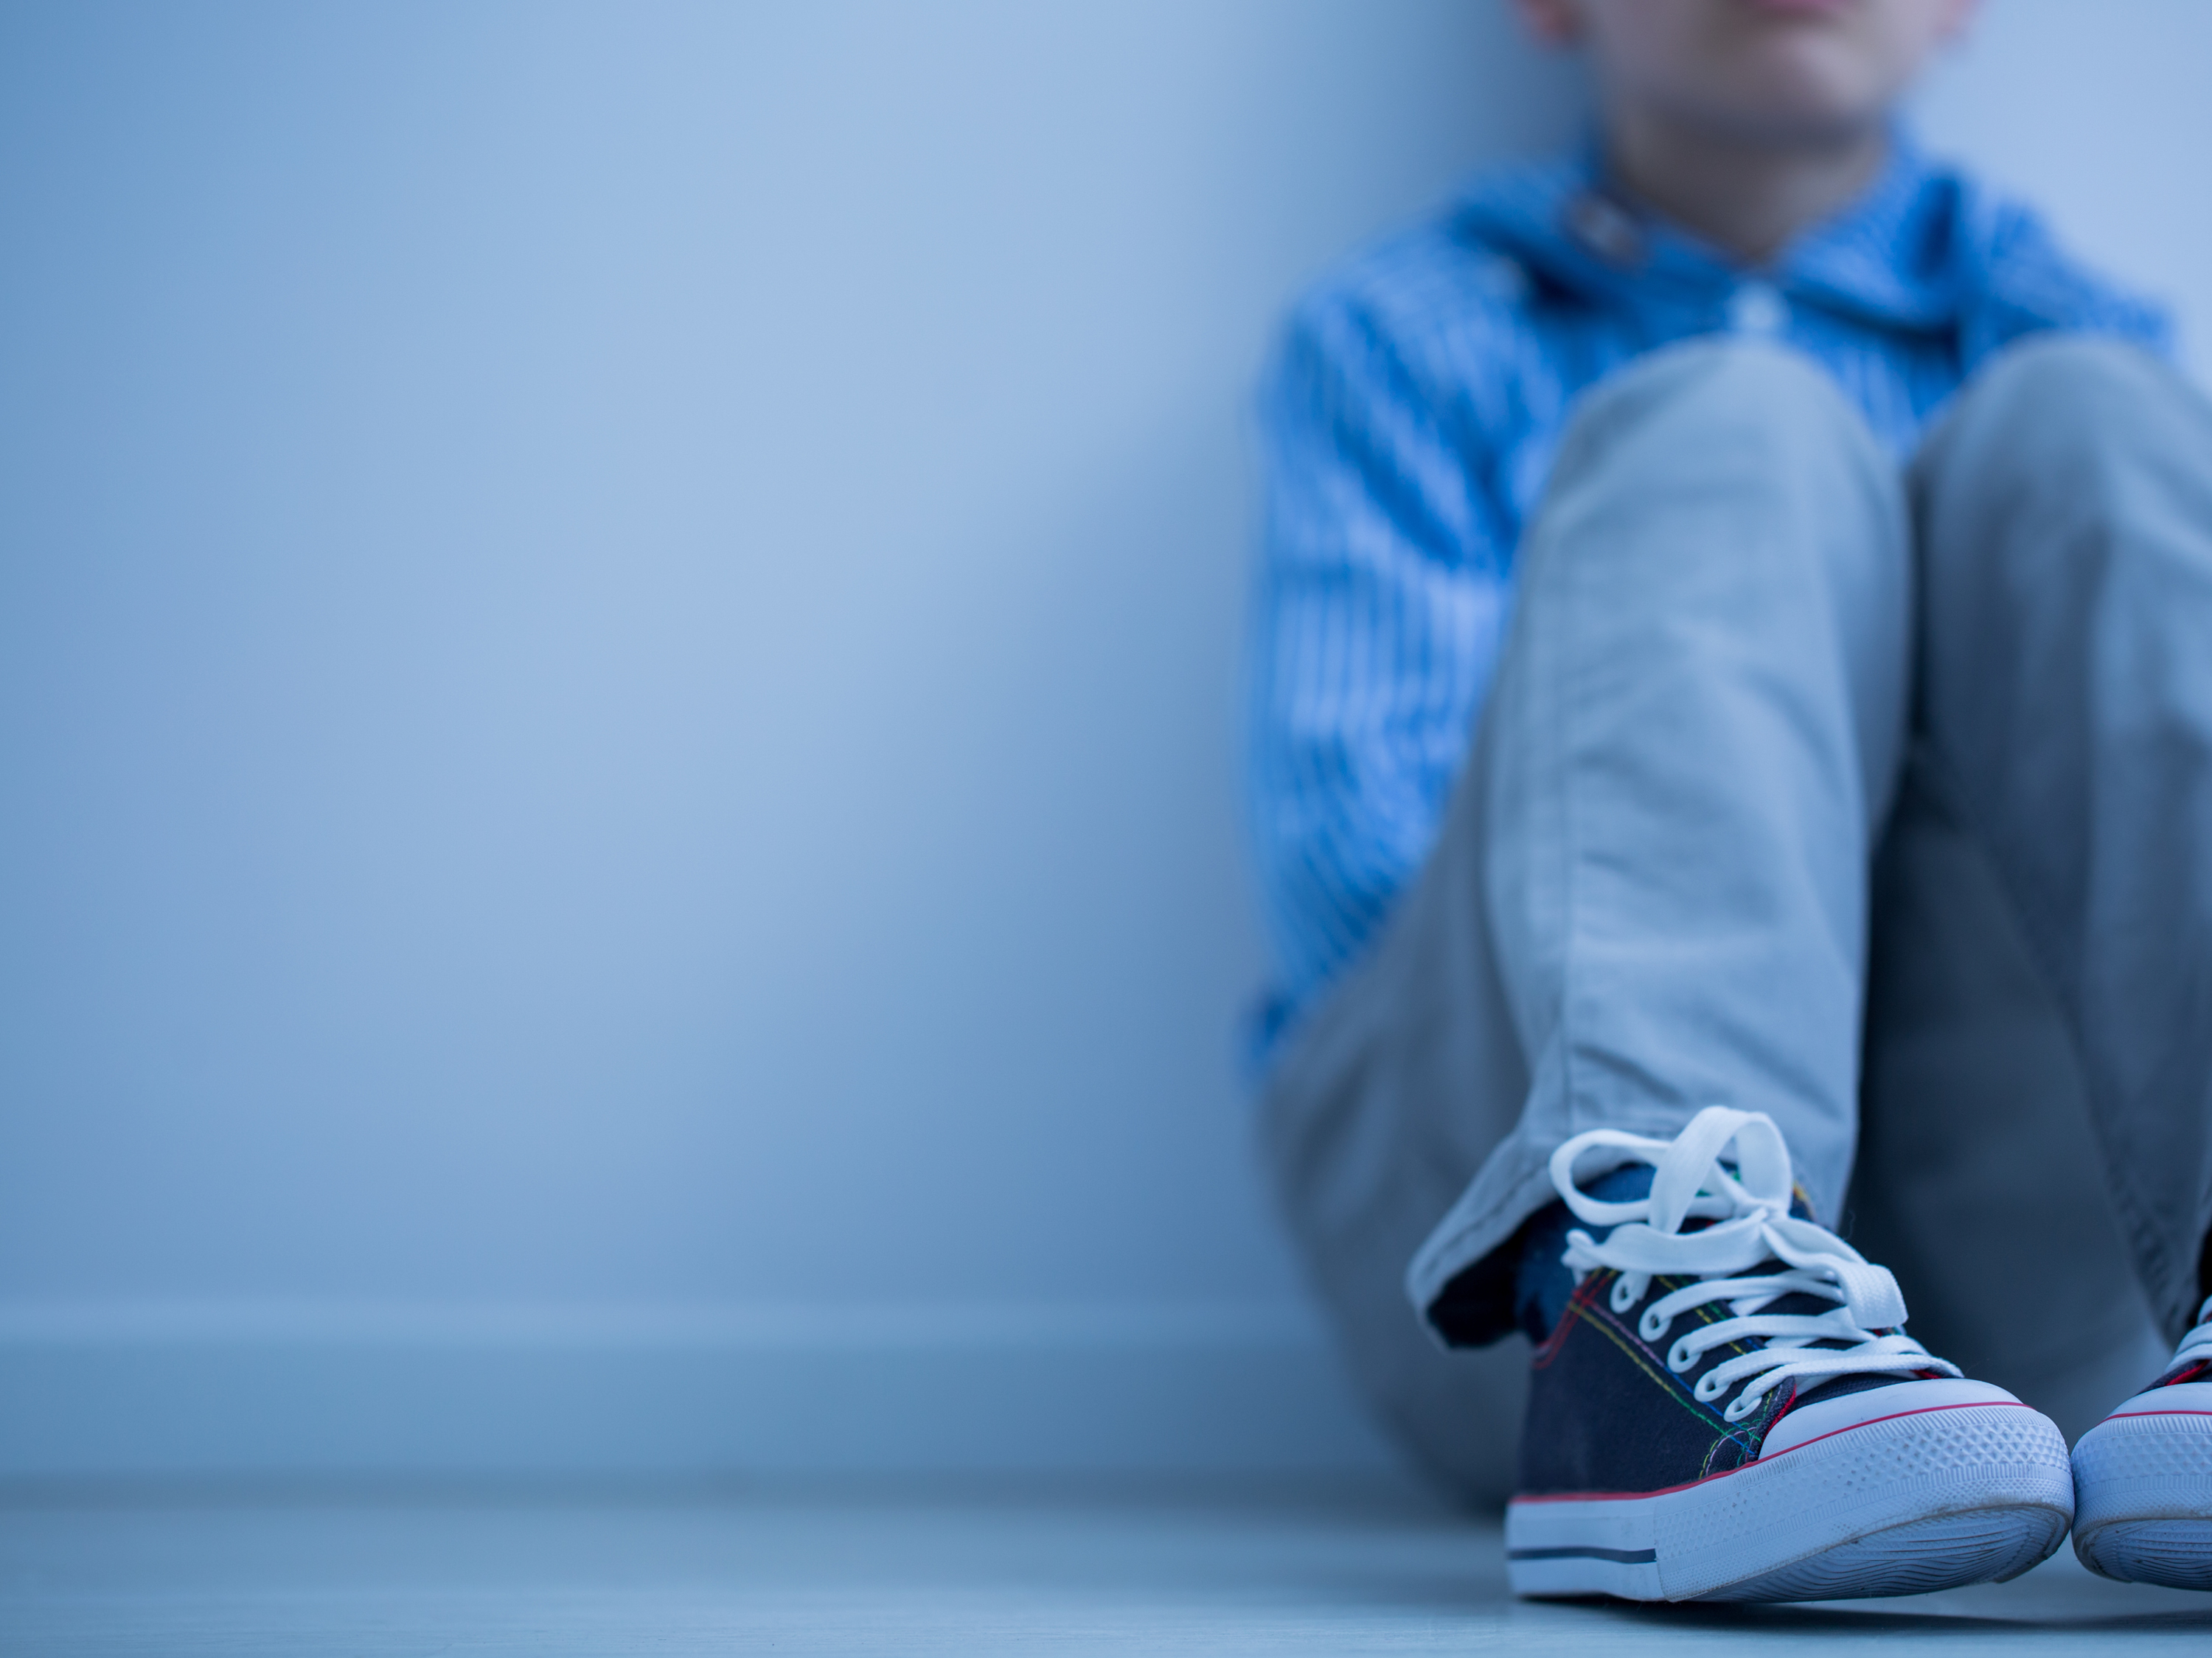
Myth:
Child human trafficking refers only to sex
Landscaping
Arts/Entertainment
Factories
Forestry
Peddling/Begging
Hotels
Hospitality
Health & Beauty
Commercial Cleaning
Carnivals
Health Care
Construction
Domestic Work
Food Service
Agriculture
Traveling Sales Crews
Illicit Massage
Pornography
Bars/Strip Clubs
Sexual Servitude

Slide 5
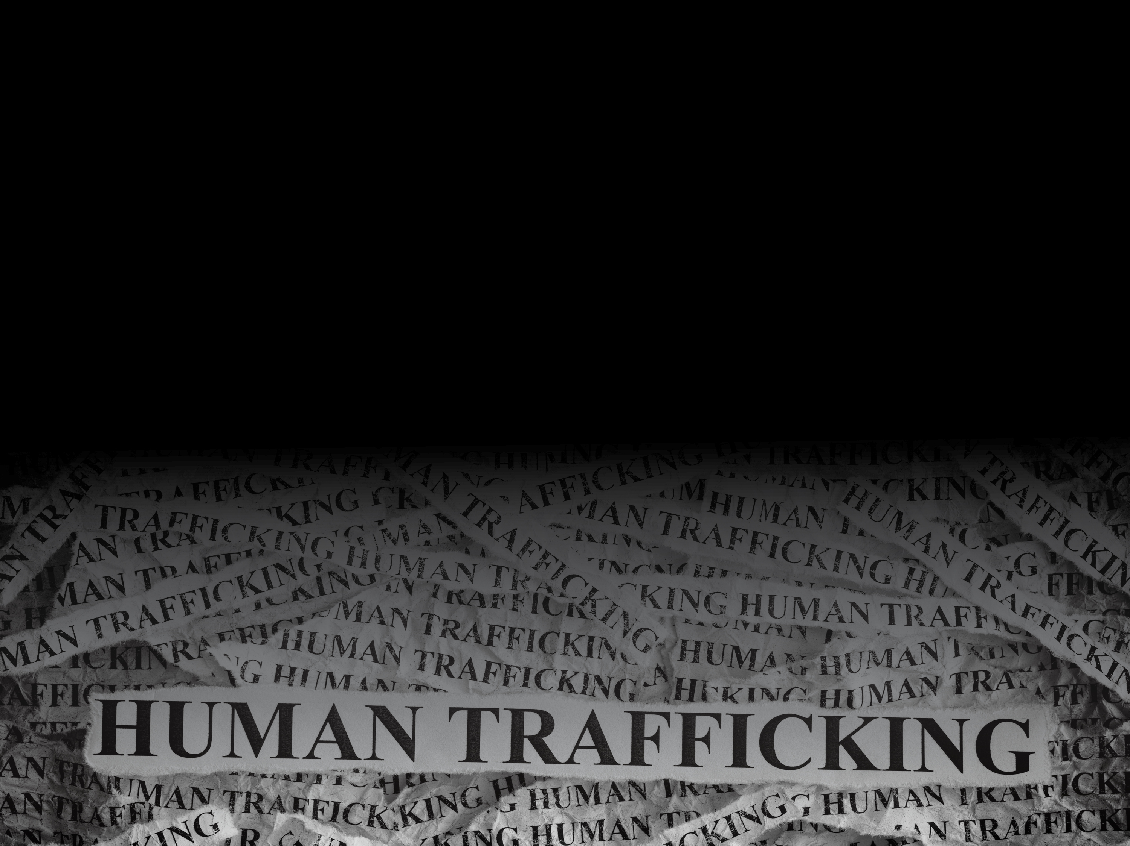
TRAFFICKING VICTIMS PROTECTION ACT
“Any person under age 18 who is induced to perform sex under any circumstances and for any reason (sex for food, shelter, clothing) and any person of any age, who is induced to perform commercial sex through fraud, force, or coercion are being trafficked.”
Difference between child and adult is 60 seconds when turning 18

Slide 6

Myth:
Most trafficking happens only abroad
40.3 million trafficked victims worldwide
U.S. ranked 1 of 3 worst worldwide
60% of trafficked victims were once in foster care,
with 12-14 average age of victim first being trafficked
130 calls a day to National Hotline
AG’s office rescued 110 in 2019
300,000 at-risk children
14% of missing children in 2018 were sex trafficked…
88% had been in child welfare system

Slide 7

Myth:
In the U.S. trafficked victims are
only immigrants and foreign nationals
LGBTQ Community
Kids with Disabilities
Racial/Ethnic Minorities
Native Americans
Kids with a History of Substance Abuse
Children in Juvenile Justice System

Slide 8

A Common Thread:
Risk Factors
Prior Sexual Violence or Abuse
Generational Poverty & Trauma
Unstable Living Conditions

Slide 9
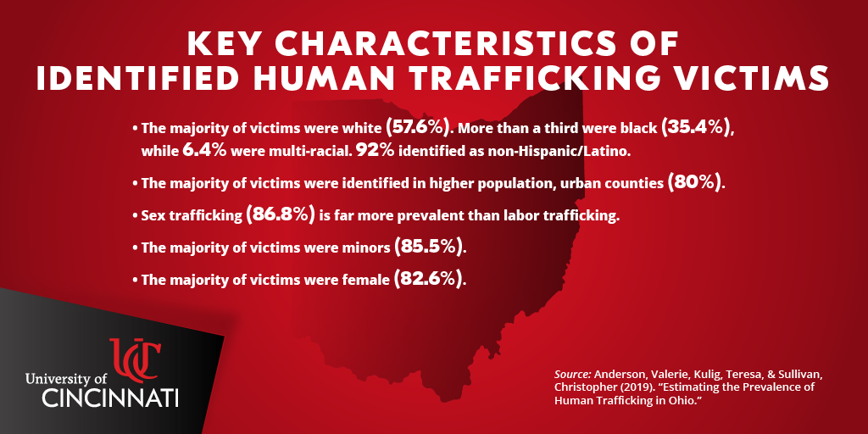

Slide 10
Myth:
Child victims want help to flee their traffickers
Don’t self-identify, so they don’t reach out
Groomed actively
Have fears
Shame
Self-blame
Rejection
Authorities
Retaliation

Slide 11
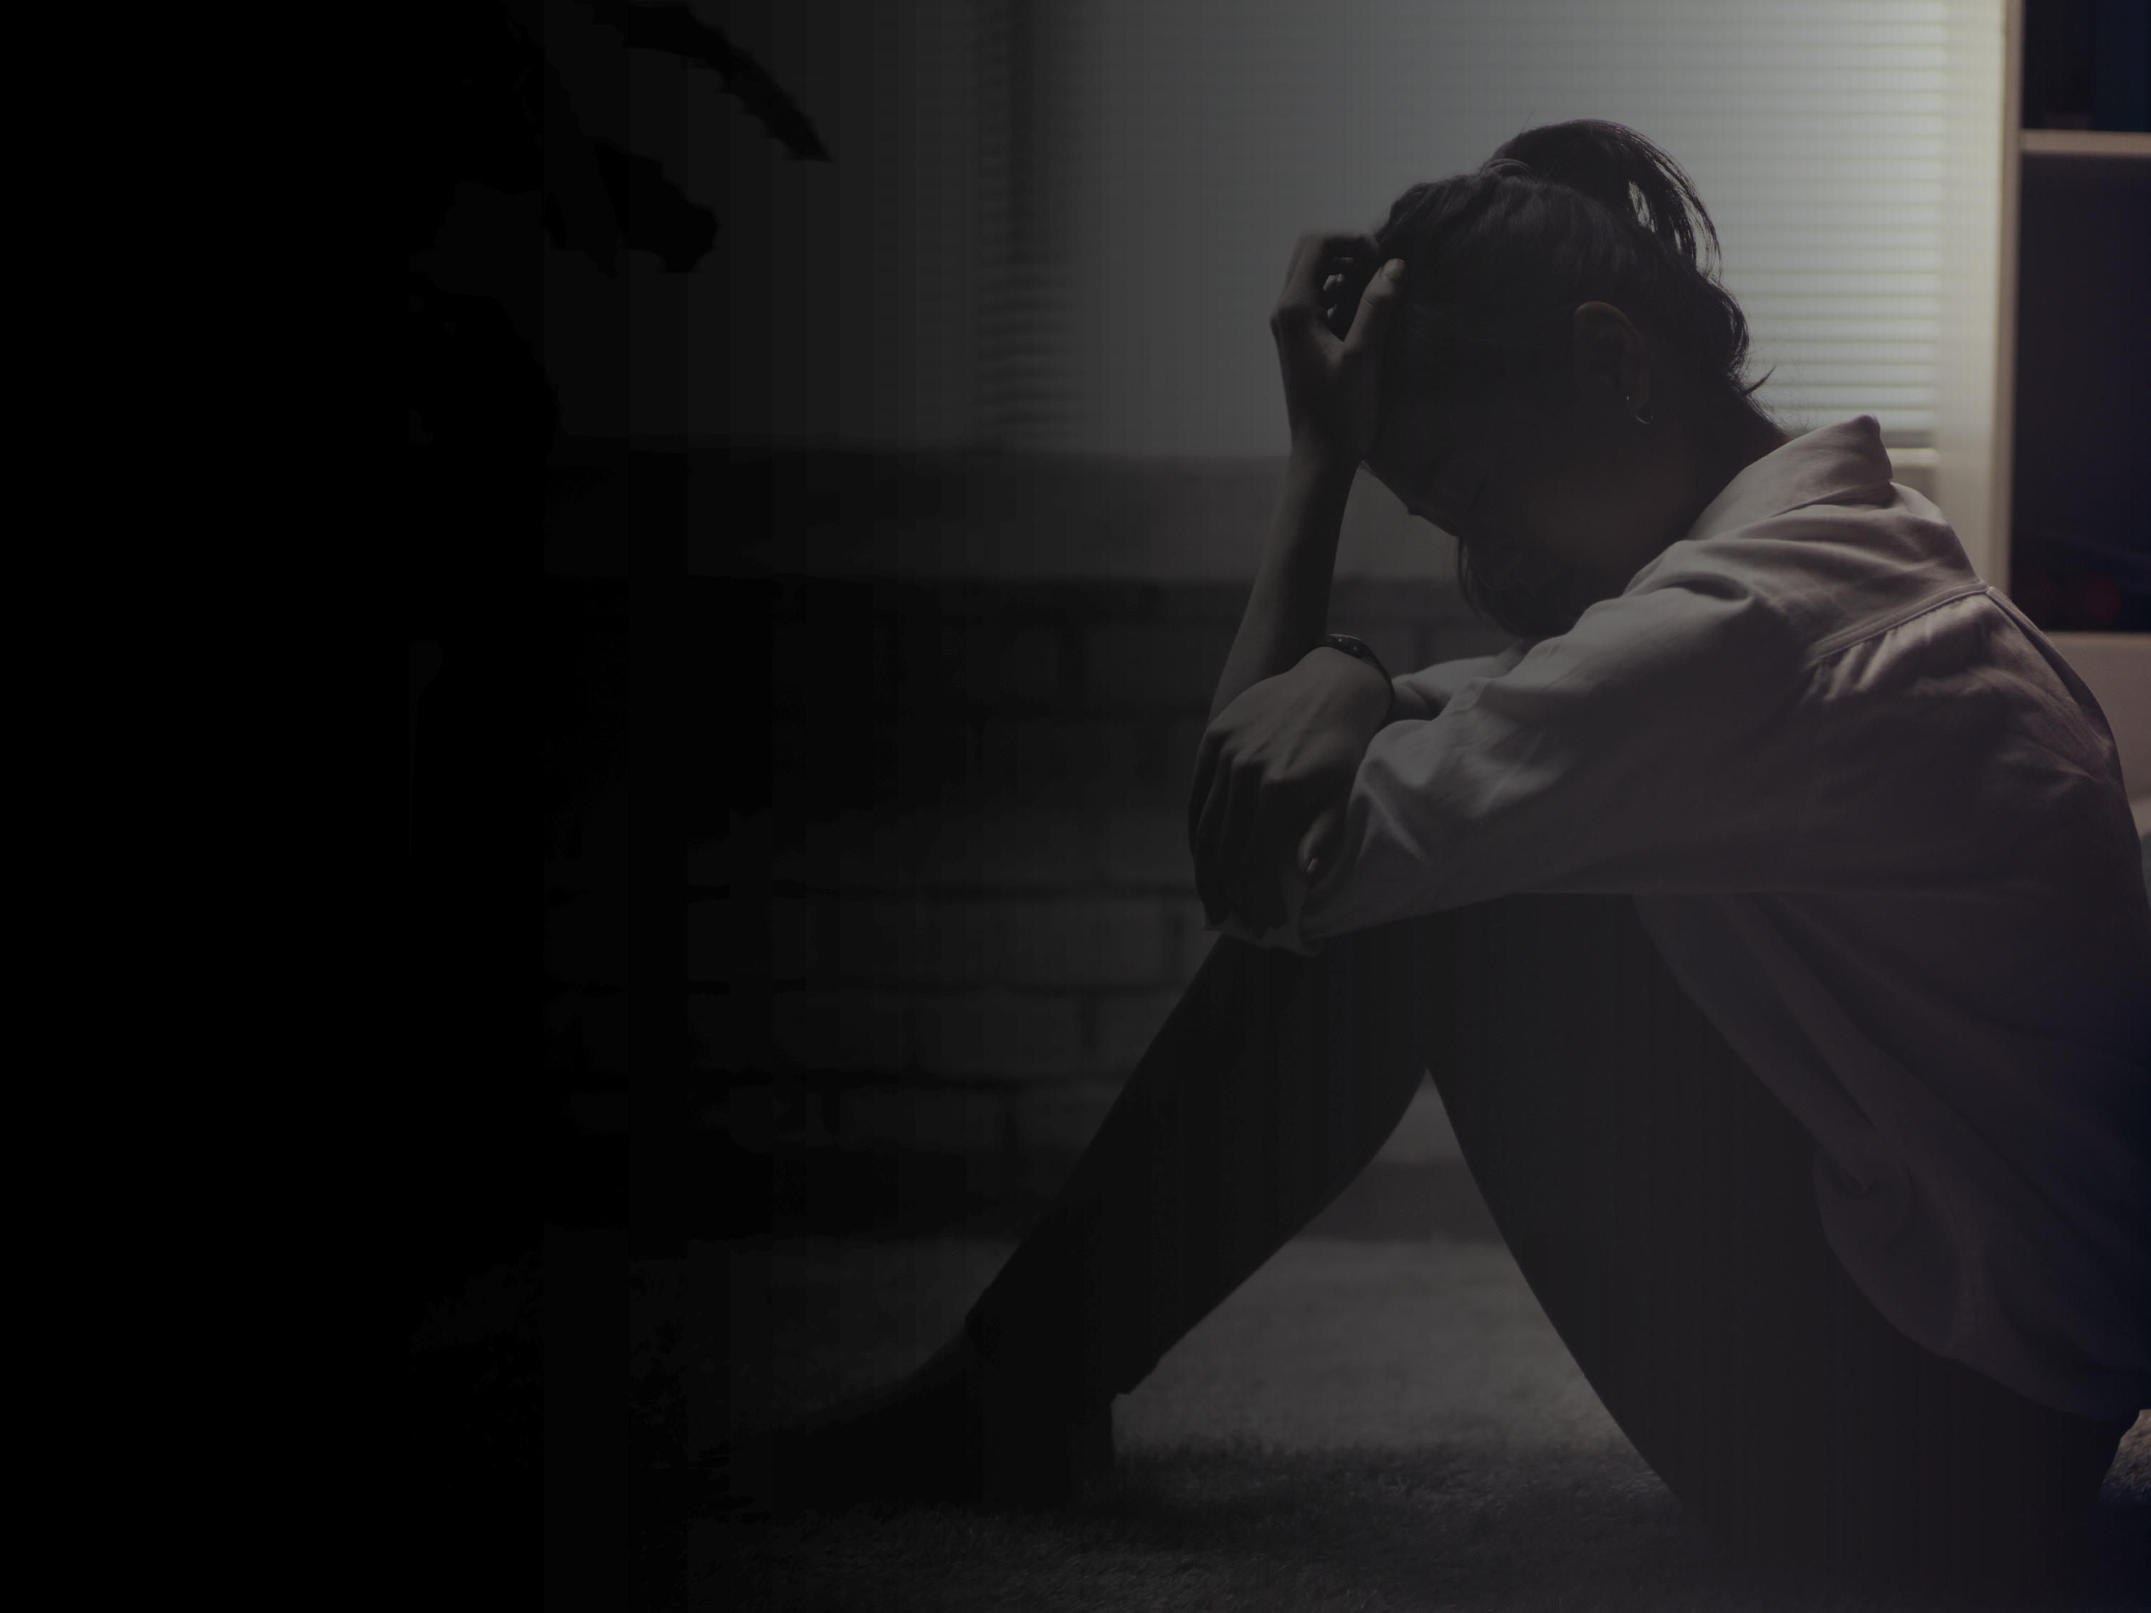
Myth:
Traffickers are strangers,
often stereotypical pimps
Friends
Boyfriends
Neighbors
Family members
Gangs/pimps
Fact:
Human trafficking is the fastest growing criminal
industry in the world, second only to the Drug Trade.

Slide 12

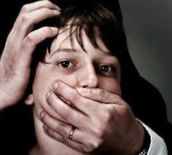
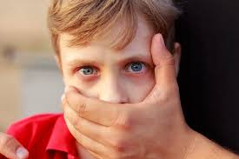
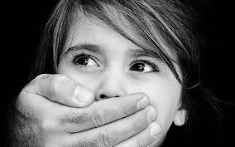
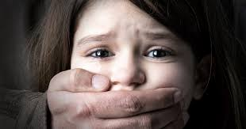
Myth:
Child trafficking could never occur in my community
No community, urban or rural, is immune

Slide 13

“I shuffled in and out of an abusive home, couch surfing from one granny or uncle to the next. By 10 the child welfare people came knocking, and I went with them with nothing. No toothbrush, no nothing. It didn’t get much better. I was just shuffled again between foster placements. One “mom” told me her paycheck would keep coming as long as I wasn’t dead. ‘Do whatever you want’ she said. By 14, I was. No difference between bringing in money for her than my pimp. He gave me gifts…I was cared for. I wasn’t being blamed for anything. He said he loved me so I could overlook being sexually abused. Nobody else wanted me. No one bothered to come looking for me. No one cared.”

Slide 14
On the Margin:
A Business Model
Scared to Testify
Trafficker source of protection
Minimal Punishment
Law is on trafficker’s side
Good Rate of Return
$75,000 a day

Slide 15
On the Margin:
A Business Model
The A-M-P Model
Action
Induce
Harbors
Means*
Force
Fraud or Coercion
Purpose
Commercial Sex (Sex Trafficking)
Labor/Services (Labor Trafficking)
Recruits
Transports
Provides or Obtains

Slide 16
On the Margin:
Connections
Face-to-Face
Internet
No man in a white van is kidnapping a youth in a parking lot!

Slide 17

On the Margin:
Recruitment
Supply Side of Business
Setting
Identification
Broken home
Need to belong
Lonely
Not protected
Lack love
Trauma history
Mall
Bus stop
Street corner
School
Group foster home
Approached while in foster care
Approached when aging out

Slide 18
On the Margin:
Tactics
Befriend as a peer or love interest
Build rapport and gain trust
Provide comfort and support
Offer love and attention
Invest time, give gifts and promise a better life
Entice with drugs and get them hooked

Slide 19
On the Margin:
Tactics
AG Dave Yost: “Today’s slave masters
use addiction, fraud, and psychological manipulation and those invisible chains hidden in the mind can be harder to break than iron chains.”
Underdeveloped skills
Little experience with developing healthy relationships
Trafficker manipulation makes bonding easier
No need for chains

Slide 20
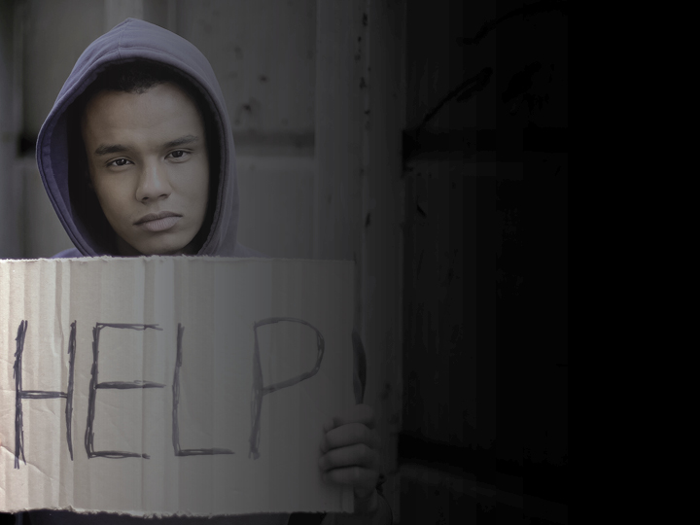
On the Margin:
More Vulnerabilities
AWOL Runaways from Foster Care
Bored and/or angry
Problems in placement
Romantically/sexually involved
Need to visit friends or family
Acting out/be in control
Emancipated Foster Youth in 2018
No permanent home (Ohio in top 10 states)
Median of 5 years in foster care/average
of 5 placements
25% no diploma or GED
Less than 2% college
50% experienced homelessness
30% experience incarceration

Slide 21
On the Margin:
Trapped
Complex Traumas Before, During and After Foster Care
“My pimp made me believe in Heaven so I was willing to
follow him to Hell.”
82% Physically Assaulted
83% Raped
27% Assaulted by Multiple Assailants
35% Broken Bones
47% Traumatic Brain Injuries
100% Addicted to Drugs
Franklin County Catch Court 2019

Slide 22
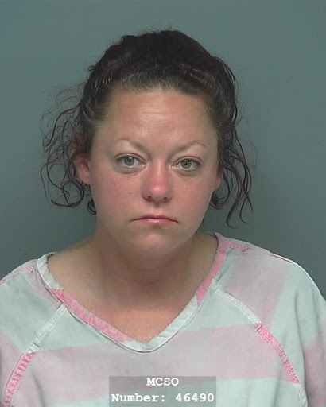
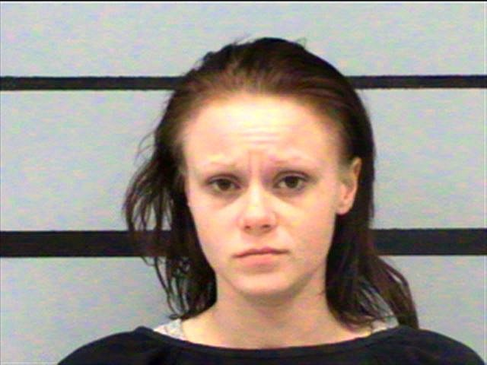
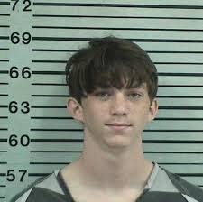
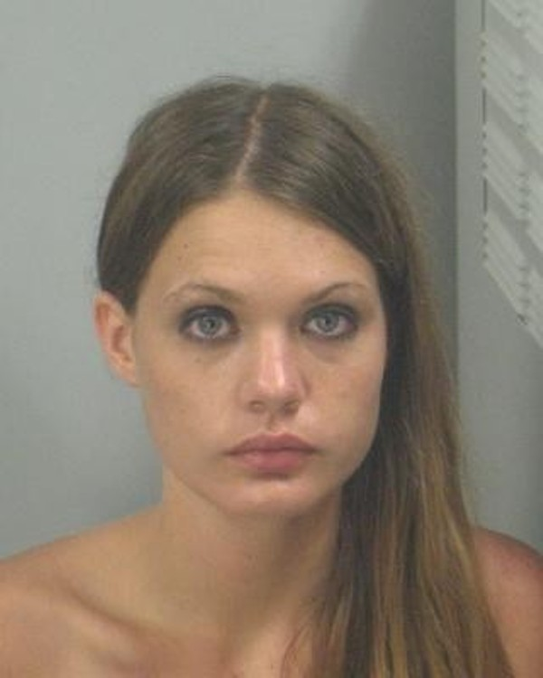
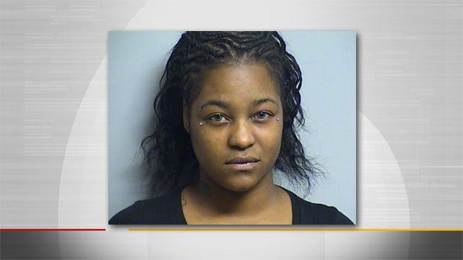
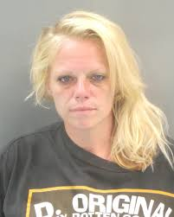
On the Margin:
Perfect Storm
Developmental Milestones – Missed
Educational/Job Opportunities – Missed
Peers/Mainstream Society – Isolated
School/Community – Disconnected
Childhood – Denied

Slide 23

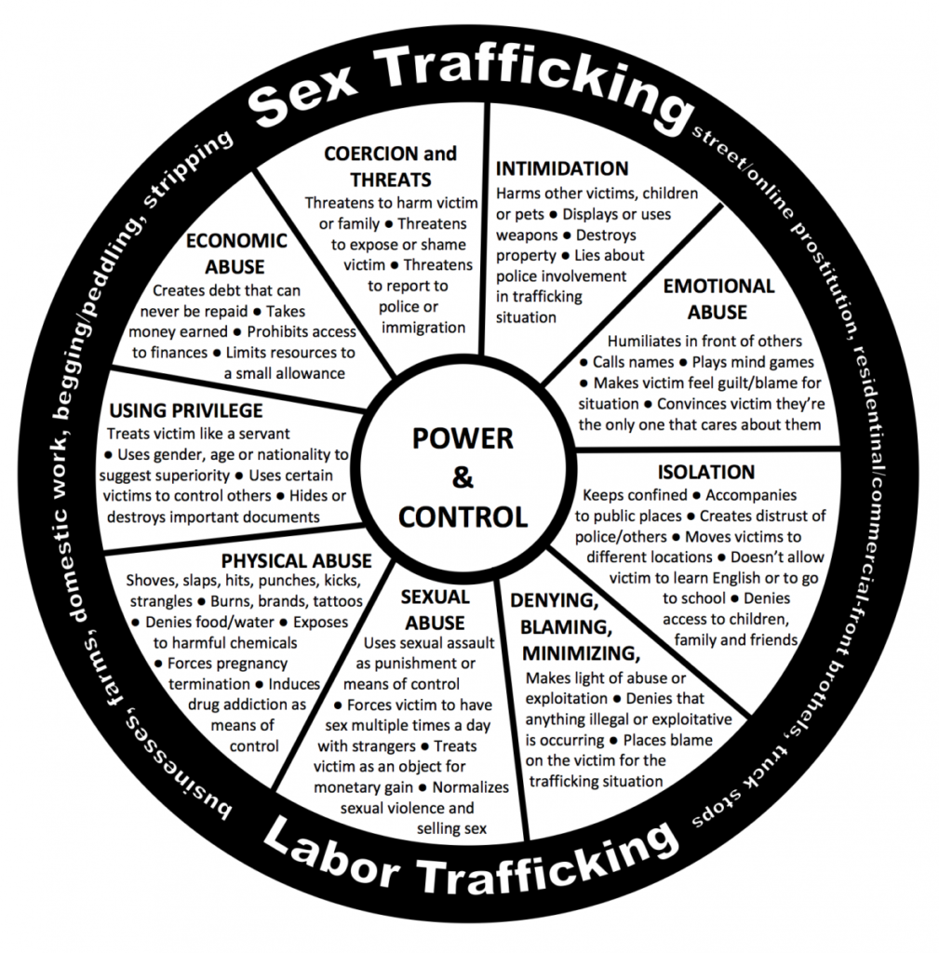
On the Margin:
Control

Slide 24
On the Margin:
Red Flags – Underlying Circumstances
Minimal support, multiple placements, homelessness, family disconnect
Family history of prostitution, abuse or neglect, domestic violence
Guardianship by unrelated adult, unwilling to give home address
Fearful of consequences for not following rules
Lives in hotel, frequent travel, concerned about immigration status

Slide 25
On the Margin:
Red Flags – Emotional & Behavioral
Signs of trauma, paranoid/fearful, guilt/shame
Emotional extremes, numbness, angry/belligerent, depressed/submissive
Behavioral changes, sleeping in school, overtly sexual, preoccupied with money
Truancy, gang affiliation, hanging out with older men/women

Slide 26
On the Margin:
Red Flags - Health
Substance abuse, unexplained bruises/injuries, chronic dental problems
Malnourishment, Hunger
Extreme fatigue
Sexually transmitted infections
Multiple pregnancies, miscarriages, terminations

Slide 27
On the Margin:
Red Flags - Appearance
Inappropriate dress–weather, location, age
Branding or tattoos
New hairstyle, professional manicure, clothes, shoes, electronics
Large amount of cash, prepaid credit cards, hotel keys, receipts, cell phones
Presence of overly controlling person
Seeking approval before answering questions

Slide 28
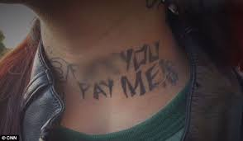
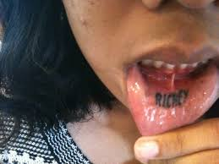
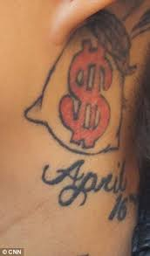
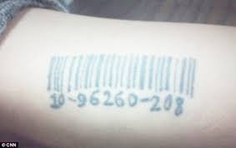
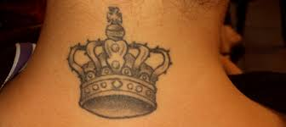
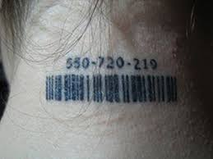
On the Margin:
Red Flags

Slide 29
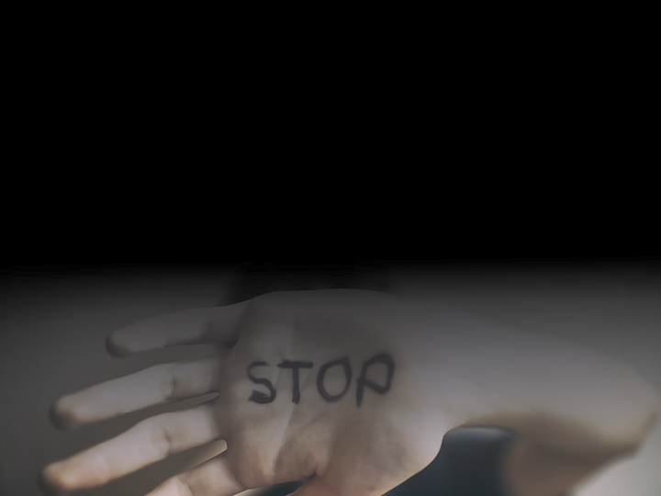
On the Margin:
What to Do
For the vulnerable foster youth among us
the moral obligation to do something rests
squarely on all of our shoulders.

Slide 30
On the Margin:
Statewide
Ohio Attorney
General’s Office
Human Trafficking
Initiative:
Ohio Organized Crime Investigations Commission
Human Trafficking Commission
Ohio Peace Officer Training Academy
Bureau of Criminal Investigation
Multidisciplinary teams
Local law enforcement
Social-service agencies
Nonprofits
Trafficking coalitions

Slide 31
On the Margin:
Statewide Goals
Address the scope of the problem–educate the public
Cut demand–catching, shaming, punishing
Change state laws–educate officers and prosecutors
Share best practices
Provide resources

Slide 32
On the Margin:
Statewide Goals
Develop Trust
with the Victims
Steer them
to Services
Nonjudgmental
Patient
Consistent
Caring
Listen when
the child talks
Identify and
address the
child’s needs
Educate on
trafficking and
social media dangers
Monitor activities
and seek help from
other professionals

Slide 33
On the Margin:
Alert Reminders
Do they have a cell phone, money or other items not
given to them?
Do they post sexually explicit material on the internet?
Do they participate in a sex act to obtain alcohol, drugs or anything else of value?
Are they friends with an overly controlling person?
Are they changing friends?
Are they having an extreme change of habits? Tattoos or branding?
Do they show signs of physical or sexual abuse?

Slide 34

On the Margin:
Safe Harbor Law
If a court has reason to believe that a juvenile is a trafficking victim, the court, under Safe Harbor provisions, can hold in abeyance the charges against the juvenile and/or the juvenile’s criminal history. The court through a series of protocols can then make diversion recommendations to protect and support the victim. R.C. 2152.021 (F), including appointing a guardian ad litem separate and apart from the defense counsel R.C. 2152.021 (F) (3) and allowing minors under 16 give testimony in preliminary hearings via closed circuit television ORC 2937.11 (D) (1) (a).

Slide 35
On the Margin:
Restore Court
Providing Wraparound Services for Holistic Help
Safe Harbor Track or Traditional Track
Mentoring – Rehab Ministries
Counseling – Trauma-informed Therapies
Case Management
Supervision & Accountability

Slide 36
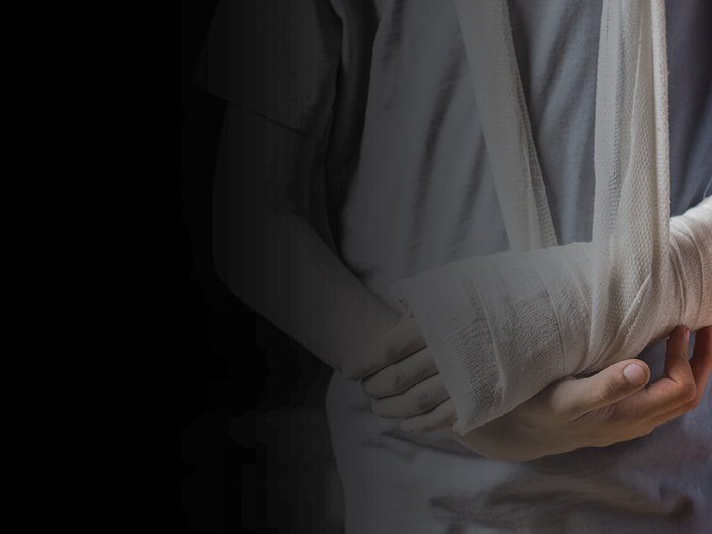
On the Margin:
S.O.A.R.
Broken bone… Trafficking?
STOP
OBSERVE
ASK
RESPOND
88% interact with heath care
worker at least once while
trafficked

Slide 37
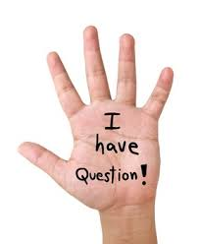
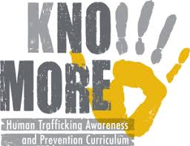
On the Margin:
Schools
Barbara Freeman (Survivor):
“I go into the schools to educate and train teachers and students. Kids need to know. Kids want to help.”
Richmond Justice Initiative Anti-Trafficking Prevention Program
Licking County North Fork Local Schools
11th State to use the curriculum
Year-long appropriate grade level
Prevention and safety

Slide 38
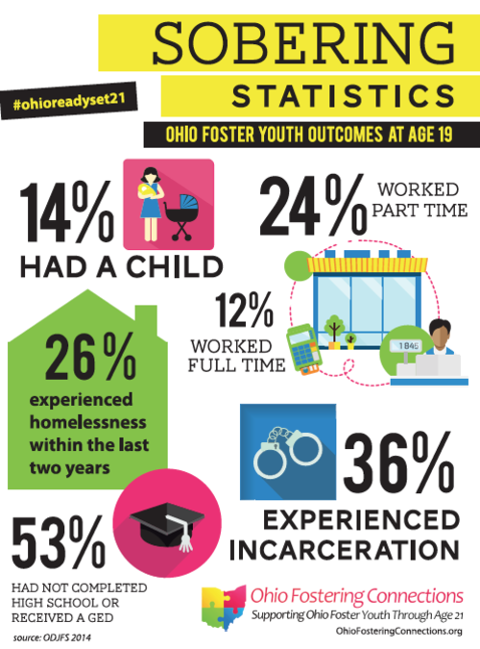

On the Margin:
ODJFS

Slide 39

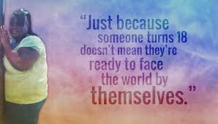
On the Margin:
Bridges
Promoting Connections Until Age 21
Housing
Physical and Behavioral Health
Services
Life Skills
Educational and Employment
Opportunities
Self-advocacy Skills

Slide 40
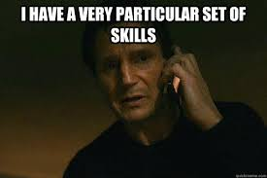
On the Margin:
Myths
Myth – Trafficked kids will just return to being
trafficked
Myth – I can do little to address this huge problem
Like Liam Neeson, you also have a very particular
set of skills

Slide 41
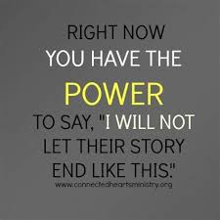
On the Margin:
First Steps
See Something – Say Something
Dispel the myths
Understand the problem
Recognize the red flags
Unite with others
Work in your community

Slide 42
On the Margin:
Second Steps
Build community awareness
person-to-person and through
social media
Assist victims; offer support
Encourage local schools to get involved
Become a mentor
Offer legal services when appropriate
Learn more though
training and practice
trauma-informed care
Support legislation
Watch for red flags;
report to authorities
Call the National Human Trafficking
Hotline at 888-373-7888 to report suspected abuse

Slide 43
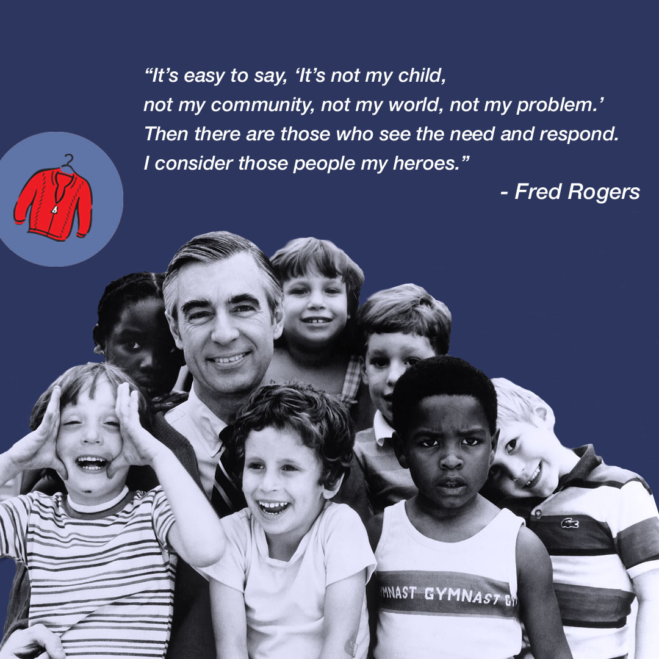
On the Margin
You won’t ever regret
being a hero.
The difference in your life is the difference you make in someone else’s.

