Slide 1


Freedom Independence Transition

Slide 2


Moving Out
?
Leases do have to be in writing.
Landlords can evict you without having to go to court.
Landlords must evict you if any illegal drug activity is taking place on the property.
You are responsible for the entire rent if a roommate moves out before the lease is up.
Landlords can keep a security deposit only if damage has been done to the property.

Slide 3
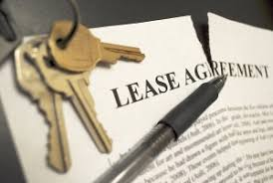
Moving Out
What is a lease?

Slide 4

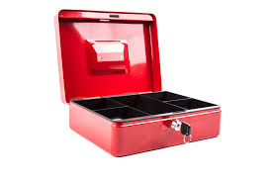
Moving Out
It’s a legal contract including:
Amount of rent
Due date of payment
Security deposit required

Slide 5
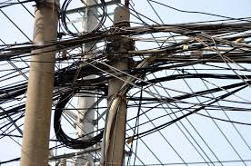
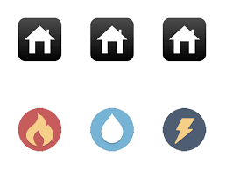
Moving Out
List of utilities included
Terms of who can live there
Tenant responsibilities
Landlord responsibilities

Slide 6
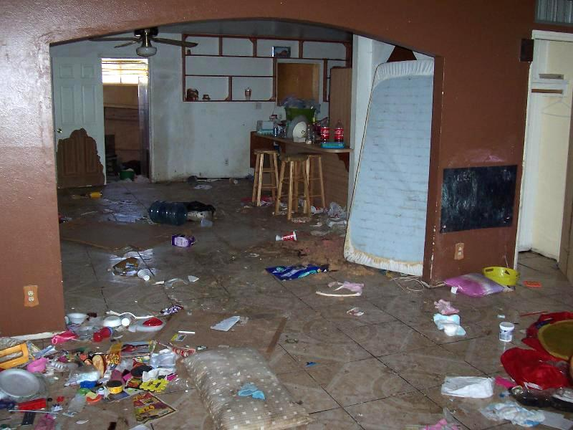
Moving Out
What are my responsibilities as a tenant?

Slide 7
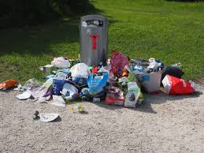

Moving Out
Paying rent
Keeping the home safe
Disposing of trash
Keeping things working properly

Slide 8
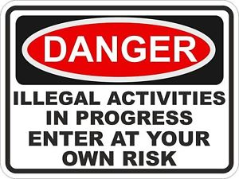
Moving Out
Not disturbing other tenant
Letting your landlord in
Preventing illegal activities
from occurring

Slide 9

Moving Out
What happens if I don’t pay my rent
or pay it on time?

Slide 10
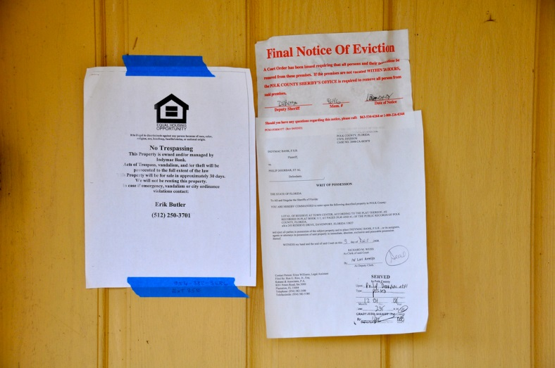
Moving Out
Eviction proceedings can begin
Court could issue an eviction notice
You could be removed from premises

Slide 11
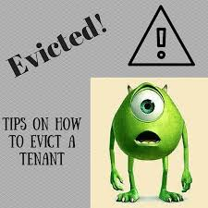
Moving Out
Are there any other reasons I could be evicted?

Slide 12

Moving Out
Staying past end of lease
Not fixing a problem you caused
Violating a term of your lease
Violating Ohio’s drug laws

Slide 13
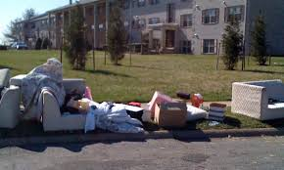
Moving Out
Is there any way to prevent eviction?

Slide 14

Moving Out
You offer to pay rent in full
Landlord has accepted partial payments
Landlord is retaliating because you exercised tenant rights

Slide 15

Moving Out
Landlord did not file proper notices
Landlord is discriminating against you

Slide 16
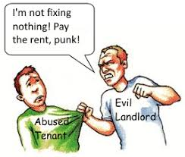
Moving Out
What’s my landlord required to do for me?

Slide 17
Moving Out
Keep apartment/public areas clean and safe
Make sure all systems work properly
Give 24 hours notice before entering
Evict tenants involved in drug activity

Slide 18

Moving Out
Is there anything my landlord can’t do?

Slide 19

Moving Out
Evict because you have complained
Change locks or shut off utilities

Slide 20

Moving Out
Enter the home improperly
Remove you without a court-ordered
eviction

Slide 21

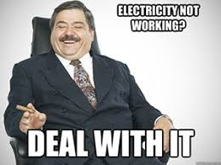
Moving Out
What if my landlord doesn’t do what he or
she is supposed to?

Slide 22

Moving Out
Keep paying rent
Try to resolve problems
Keep records of your requests/Contact
local authorities
Seek legal advice

Slide 23


Moving Out
What if I want to move out before my lease
is up?

Slide 24

Moving Out
Still responsible for rent
Could sublet if landlord agrees
Check lease for any “outs”
Work out a new agreement

Slide 25

Moving Out
Should I give advanced notice when I plan
to leave and end my lease?

Slide 26

Moving Out
Yes...
Check lease for details of leaving
Don’t let it automatically renew by not
providing notice

Slide 27

Moving Out
If I sign a lease with friends and they move
out, am I responsible for the full rent?

Slide 28


Moving Out
Ask before you sign lease
Chose roommates wisely
Suing is costly

Slide 29


Moving Out
How do I get my security deposit back?

Slide 30

Moving Out
Inspect rental before you move in
Take pictures of any damage and report to
landlord
Remove belongings and all trash

Slide 31
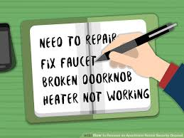
Moving Out
Clean home before you move
Conduct another inspection
Take pictures/note any damage
Leave forwarding address

Slide 32

Moving Out
Landlord can keep money if you owe back
rent, utilities, or have done damage
Landlord is required to return money within
30 days of move or give written statement as to why not

Slide 33
Moving Out
Leases do have to be in writing. | False
Landlords can evict you without having to go to court. | False
Landlords must evict you if any illegal drug activity is taking place on the property. | True
You are responsible for the entire rent if a roommate moves out before the lease is up. | True
Landlords can keep a security deposit only if damage has been done to the property. | False

