Slide 1


Freedom Independence Transition

Slide 2


Managing Medical Issues
You can be on your parents medical policy until you marry or graduate from college if you are willing to pay the premiums
HIPAA privacy rules prevent third parties from gaining your medical information without your permission.
Since you don’t have any significant possessions, you don’t need a living will yet.
Other people cannot get involved with making decisions about a person’s mental health or drug-related issues
?

Slide 3

Managing Medical Issues
Can my parents’ medical policy still cover me even if I am 18?

Slide 4

Managing Medical Issues
Yes, until you are 26...
Plan allows it
Premiums are paid
Parents agree

Slide 5
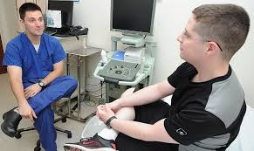
Managing Medical Issues
What if I am on my own?

Slide 6

Managing Medical Issues
Can get insurance from the Affordable Care Act

Slide 7

Managing Medical Issues
What if I can’t afford health care on my own?

Slide 8
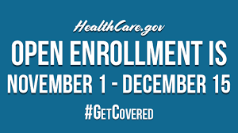
Managing Medical Issues
Check out options at www.HealthCare.gov
Could qualify for assistance
Could qualify for Medicaid

Slide 9

Managing Medical Issues
What is HIPAA and why should I care?

Slide 10

Managing Medical Issues
Shorthand for Health Insurance Portability and Accountability Act
Privacy Rule kicks in at 18
Written consent to share information

Slide 11



Managing Medical Issues
Will the doctors and the hospital still talk to my parents, my roommate, or significant other about my condition?

Slide 12

Managing Medical Issues
Probably not...
A written disclosure statement is needed before a medical issue arises

Slide 13

Managing Medical Issues
So what if I am in a hospital heavily
sedated and unable to talk? Can’t
trusted people in my life find out
what’s going on?

Slide 14
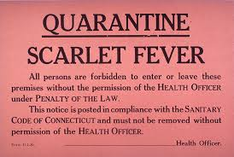

Managing Medical Issues
Not really until you sign a release
Can only see you

Slide 15

Managing Medical Issues
What can I do to have others intervene on my behalf?

Slide 16


Managing Medical Issues
Set up an Advance Directive
Health Care Power of Attorney
Living Will

Slide 17


Managing Medical Issues
Aren’t these decisions really for the elderly?

Slide 18



Managing Medical Issues
Think car accident
Think work-related accident
Think distance away from loved ones

Slide 19

Managing Medical Issues
Do I need both a Power of Attorney and a Living Will?

Slide 20

Managing Medical Issues
Courts will assign a guardian if you don’t
have a Power of Attorney and are unable
to communicate

Slide 21
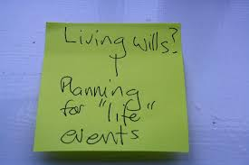
Managing Medical Issues
Living Will tells health officials what
they can and cannot do

Slide 22
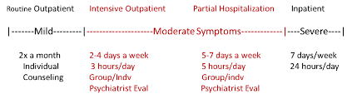
Managing Medical Issues
What if I am coping with some mental health
issues or drug-related issues? Can I get
other people involved in making decisions
about my care?

Slide 23


Managing Medical Issues
Yes, of course...
Declarations of Mental Health Treatment

Slide 24

Managing Medical Issues
What do I do with all of these documents once I make my decisions?

Slide 25

Managing Medical Issues
Make several copies (keep one)
Give copy to your HealthCare Power of Attorney designee
Leave a copy with your physician

Slide 26
Managing Medical Issues
You can be on your parents medical policy until you marry or graduate from college if you are willing to pay the premiums | True
HIPAA privacy rules prevent third parties from gaining your medical information without your permission. | True
Since you don’t have any significant possessions, you don’t need a living will yet. | False
Other people cannot get involved with making decisions about a person’s mental health or drug-related issues | False

