Slide 1


Freedom Independence Transition

Slide 2


Encountering the Police
A police officer is allowed to search a car.
Police officers don’t take a defensive posture just for a traffic stop.
You are the one most responsible for not escalating a confrontation with police.
The police can pat you down even if you have done nothing wrong.
The typical police warning about your rights when being arrested does not include being told why you are being arrested.

Slide 3
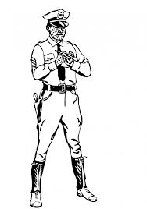

Encountering the Police
Aren’t police officers supposed to follow “the laws” when they approach a person?

Slide 4
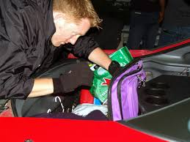
Encountering the Police
Yes...
No random searches
Reasonable suspicion

Slide 5
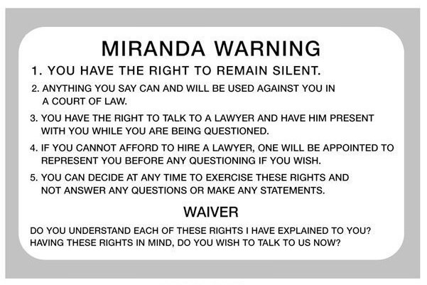
Encountering the Police
“Plain view” doctrine
Miranda warning

Slide 6
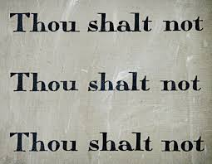
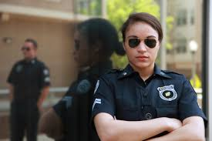
Encountering the Police
What about standard procedures police should follow as to how they act?

Slide 7
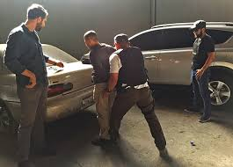
Encountering the Police
Protective practices

Slide 8
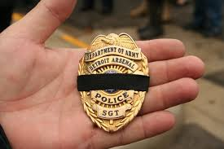
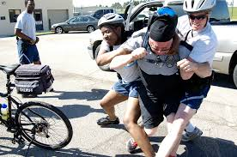
Encountering the Police
Defensive postures
Risk of harmful confrontation

Slide 9
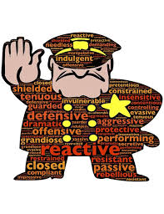
Encountering the Police
How should I act when approached by the police?

Slide 10

Encountering the Police
Be mature and non-confrontational
Collect your thoughts

Slide 11

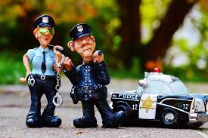
Encountering the Police
Follow orders
No threatening words/actions

Slide 12

Encountering the Police
Keep hands where officers can see them
Don’t resist a pat-down

Slide 13
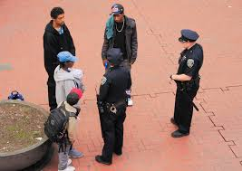

Encountering the Police
Explain your side if asked
Gather witnesses’ names

Slide 14
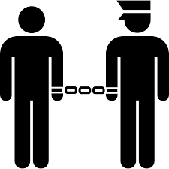
Encountering the Police
What happens if I am actually arrested?

Slide 15
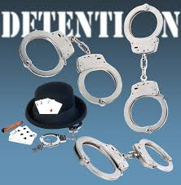
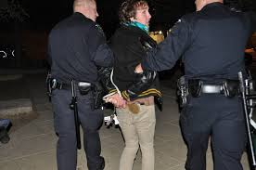
Encountering the Police
Will be searched and handcuffed

Slide 16


Encountering the Police
See the warrant for arrest if police have one
Listen for Miranda warning

Slide 17
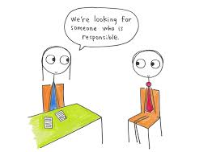
Encountering the Police
Contact a responsible person
Have an attorney present before answering
questions or signing anything

Slide 18




Encountering the Police
Control your emotions

Slide 19
Encountering the Police
A police officer is allowed to search a car. | True (reasonable suspicion)
Police officers don’t take a defensive posture just for a traffic stop. | False
You are the one most responsible for not escalating a confrontation with police. | True
The police can pat you down even if you have done nothing wrong. | True
The typical police warning about your rights when being arrested does not include being told why you are being arrested. | False

