Slide 1


Freedom Independence Transition

Slide 2


Considering Sex
An 18-year-old can have sex with someone under 16 if it is consensual
Only when sexual conduct is unwanted is it considered a crime
Penalties for sexual assault are uniformly set in law
If you are married, you cannot be accused of raping your spouse
“Date rape” describes forcible sexual intercourse between two people who have a pre-existing relationship.

Slide 3

Considering Sex
Can we have sex if one of us is younger
than the other?

Slide 4


Considering Sex
It’s illegal if...
One person is under 16
Consent doesn’t protect the 18-year-old
Sexual exploitation becomes the
issue

Slide 5

Considering Sex
What is sexual battery?

Slide 6
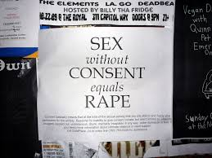
Considering Sex
Unwanted sexual conduct
Threat of force (rape)

Slide 7
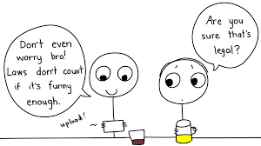
Considering Sex
What are the penalties?

Slide 8


Considering Sex
Determined by circumstances
Fines and/or jail time

Slide 9


Considering Sex
Registration as a sex offender
Treatment for being a sex offender

Slide 10
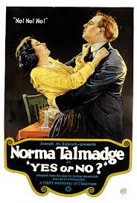

Considering Sex
When does “no” mean “no?”
When does “yes” mean “yes?”

Slide 11

Considering Sex
Significant questions arise about what constitutes consent or refusal
Lack of protest or resistance doesn’t mean consent

Slide 12

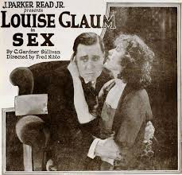
Considering Sex
Current or past encounters do not
constitute consent

Slide 13
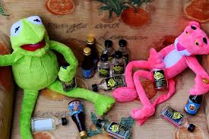
Considering Sex
Unconscious or too drunk is not an excuse
Authority figure can’t claim consent

Slide 14


Considering Sex
Drugs or drink doesn’t avoid responsibility for consent
Consent can be withdrawn

Slide 15
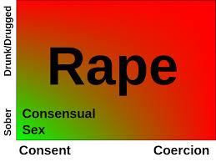

Considering Sex
What is “date rape”?

Slide 16

Considering Sex
Forcible sexual intercourse between two
people who have a pre-existing relationship

Slide 17
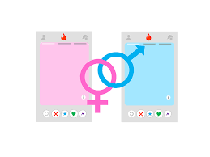

Considering Sex
Going out for first time is pre-existing
People who know each other
No pass for previous encounters

Slide 18
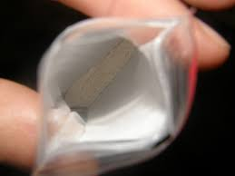

Considering Sex
What are “date rape” drugs?

Slide 19
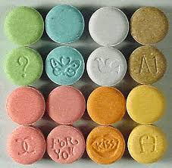
Considering Sex
Club drugs such as GHB, Rohypnol, and
Ketamine which are often slipped into drinks
Tougher penalties imposed for their use

Slide 20
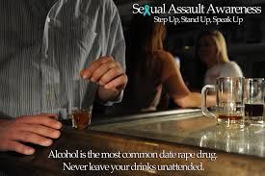
Considering Sex
Safeguards should be used…
Open your own containers
Don’t accept drinks from others
Don’t share drinks

Slide 21
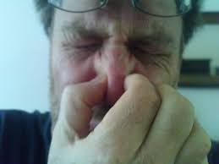
Considering Sex
Pour out unattended drinks
Don’t drink from a punch bowl
Don’t drink something with funny
smell or taste

Slide 22


Considering Sex
If you think you have been drugged…
Get to the hospital
Bring drink along

Slide 23


Considering Sex
Test for date drugs immediately
Ask to be examined for possible
sexual assault

Slide 24


Considering Sex
What should I do if I am sexual harassed
at work?

Slide 25
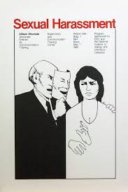
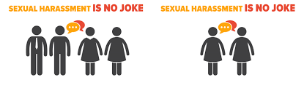
Considering Sex
Understand what it is…
Pressure for sexual favors
Unwelcomed jokes or comments
Degrading pictures

Slide 26

Considering Sex
Can file a charge of discrimination
…Ohio Civil Rights Commission
…Equal Employment Opportunity
Commission
Can file a lawsuit

Slide 27
Considering Sex
An 18-year-old can have sex with someone under 16 if it is consensual | False
Only when sexual conduct is unwanted is it considered a crime | False
Penalties for sexual assault are uniformly set in law | False
If you are married, you cannot be accused of raping your spouse | False
“Date rape” describes forcible sexual intercourse between two people who have a pre-existing relationship. | True

