Slide 1


Freedom Independence Transition

Slide 2


Having Fun
If you’re 18 and at college, most people are going to overlook your drinking.
I am liable if someone under 21 crashes my party without my permission to be there and drinks..
If I have been drinking but call for help for a buddy who is overdosing, I can get in trouble.
If I smell of alcohol but am not drinking at a tailgate, I can still be arrested.
I can be arrested if my friend has drugs on him but I don’t when the cops pull us over.

Slide 3


Having Fun
Don’t most people overlook the drinking of alcohol by an 18-year-old?

Slide 4


Having Fun
Only three exceptions...
Parental consent
Religious Service
Doctor’s prescription

Slide 5

Having Fun
Can I get in trouble if I have a party and
some of the people drinking aren’t 21?

Slide 6
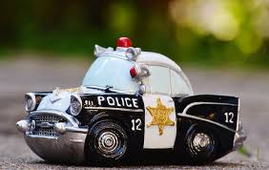
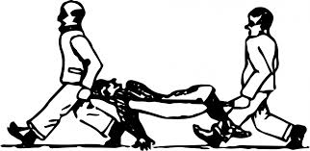
Having Fun
Yes...
If the police show up
If you allow anyone under 21
to remain
If someone is injured or dies

Slide 7

Having Fun
What happens if someone crashes my party?

Slide 8

Having Fun
They are trespassing
You can call the police if they
won’t leave

Slide 9
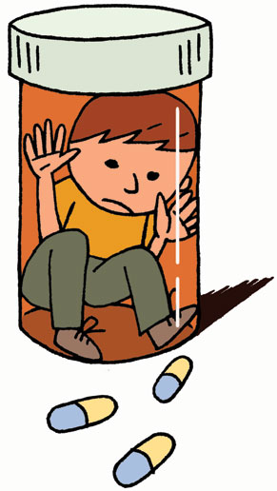
Having Fun
What should I do if someone has had too much to drink or is overdosing on drugs and needs medical help?

Slide 10

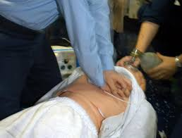
Having Fun
Call 911 immediately
Stay with the person until help
arrives
Cooperate with the authorities

Slide 11

Having Fun
What about fake IDs or altering my driver’s license to make it read 21?

Slide 12

Having Fun
Criminal offense
Stores ID and are liable
Cameras roll 24/7

Slide 13
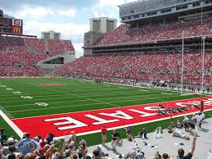
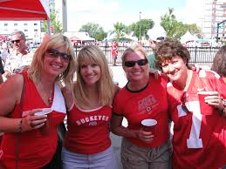

Having Fun
If I have been drinking privately, but then go out in public, say, to a tailgate, can I still be arrested?

Slide 14


Having Fun
Yes, and you’re taking a risk...
Smell is enough for an arrest
Chance of disorderly conduct

Slide 15
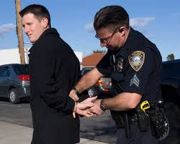
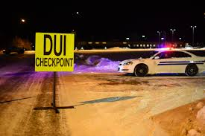
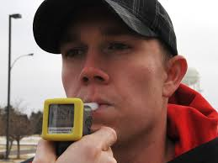
Having Fun
What happens if I am caught drinking and driving between 18 and 20?

Slide 16
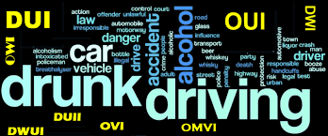
Having Fun
Not legal
Limit for being drunk is lower
Charged with OVI

Slide 17

Having Fun
What happens if I am arrested for possession of drugs

Slide 18
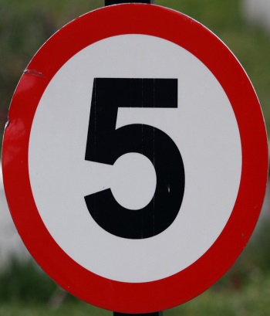
Having Fun
It depends...Ohio has five drug “Schedules”
Type of drug
Amount of drug

Slide 19
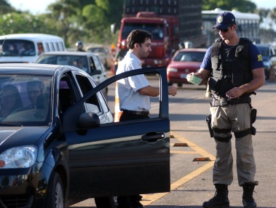
Having Fun
If we are stopped by the police and I am riding with someone who is carrying drugs, can I be charged with possession when the drugs aren’t mine?

Slide 20


Having Fun
Not-so-easy answer is “yes,” if found in the car...
Access to take possession
(gray area)
Defense if not found on you

Slide 21
Having Fun
If you’re 18 and at college, most people are going to overlook your drinking. | Not necessarily
I am liable if someone under 21 crashes my party without my permission to be there and drinks. | True
If I have been drinking but call for help for a buddy who is overdosing, I can get in trouble. | False
If I smell of alcohol but am not drinking at a tailgate, I can still be arrested. | True
I can be arrested if my friend has drugs on him but I don’t when the cops pull us over. | True

