Slide 1



Slide 2

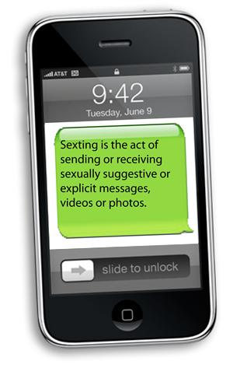
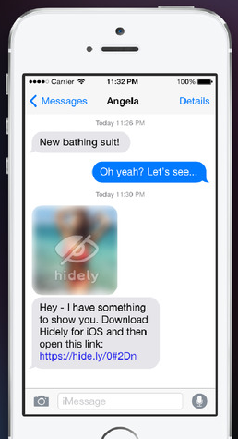
Definitions

Slide 3

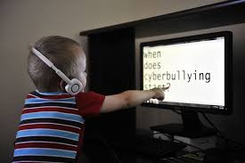
Definitions
Cyber bullying is the use of online activities to harass…torment…humiliate…embarrass…badmouth
and be mean to others.

Slide 4
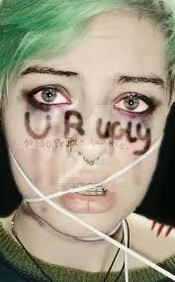
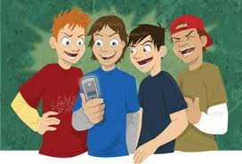
Definitions
It’s “electronic aggression” mostly over cellphones…computers…and tablets.

Slide 5
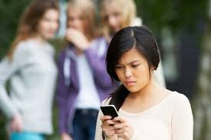
Fast Facts
87% have witnessed cyberbullying
59% have been cyberbullied
Teens are 7 times more likely to experience cyberbullying

Slide 6
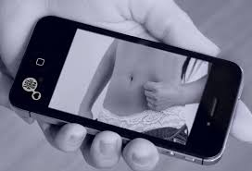
Fast Facts
1 in 7 teens have posted sexually suggestive messages and 1 in 4 have received them.
12% forward a sext without consent.

Slide 7

Fast Facts
2.23 billion people on Facebook (1 out of 6)
336 million active Twitter users (500 million Tweets a day...unfiltered and unchecked)
One’s accounts are open to these potential numbers
The world is watching...forever

Slide 8


Fast Facts
YouTube
Snapchat
Musical.ly
Viber
WeChat
WhatsApp
Instagram
Twitter
Hundreds more…

Slide 9
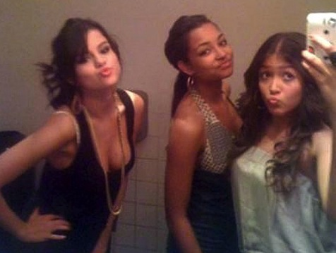

Fast Facts
Too often kids sext or cyberbully because they think it’s just a new way to make out, a prank, or “just what kids do nowadays.”
Too often kids can be as mean as they want because they can be anonymous.

Slide 10
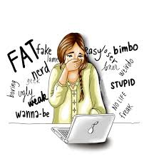
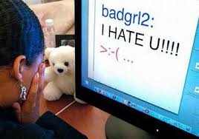
Fast Facts
Some people post hateful comments about…
Race
Religion
Ethnicity
Personal characteristics

Slide 11
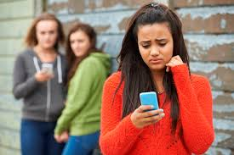
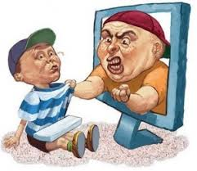
Fast Facts
Some people…
Threaten to hurt someone
Tell a person to kill himself
Post lies

Slide 12
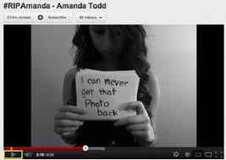

Fast Facts
Nothing sent digitally is ever truly private, taken back, or deleted.
Once posted the sender loses complete control of where the message will end up for all time.

Slide 13

Consequences of Sexting
The student can be embarrassed, humiliated and even blackmailed by someone who receives the message.
A student can be pegged or stereotyped.
A student’s reputation is at great risk forever.

Slide 14
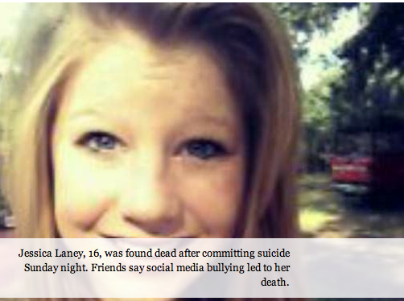
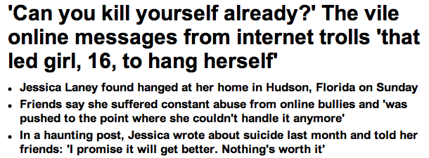
Consequences of Sexting
  Phone companies can shut down your account.
Teens are not immune to
suicide.

Slide 15
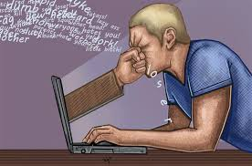
Consequences of Cyberbullying
A battle of words can take place.
The target can cyberbully back.
Both can get in trouble at home, school, or with the law.

Slide 16

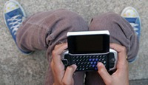
Consequences of Cyberbullying
Depression…loss of self-esteem…anxiety…fear…frustration…and isolation can occur.

Slide 17
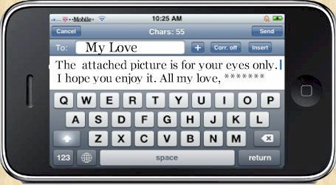
Legal Concerns
Sexting is illegal. A student sending the message can be charged with distributing child pornography.
The student receiving the message can be charged with possessing child pornography.
Both can be labeled as sexual offenders.

Slide 18
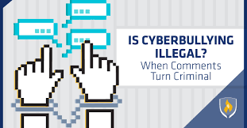
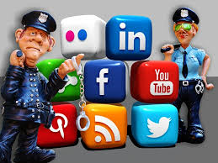
Legal Concerns
Cyberbullying is illegal because it is menacing
…Telecommunications Harassment Law
…Menacing by Stalking law

Slide 19
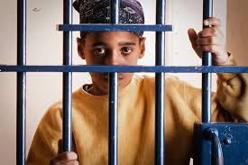

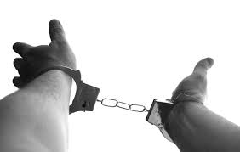
Legal Punishments
Community service
Fines
Juvenile Jail
Registration as a juvenile sex offender
Probation/Diversion program

Slide 20


Stop the Digital Misuse
Take a deep breath.
Stay calm.
Give yourself time thoughtfully to handle unwanted messages.

Slide 21
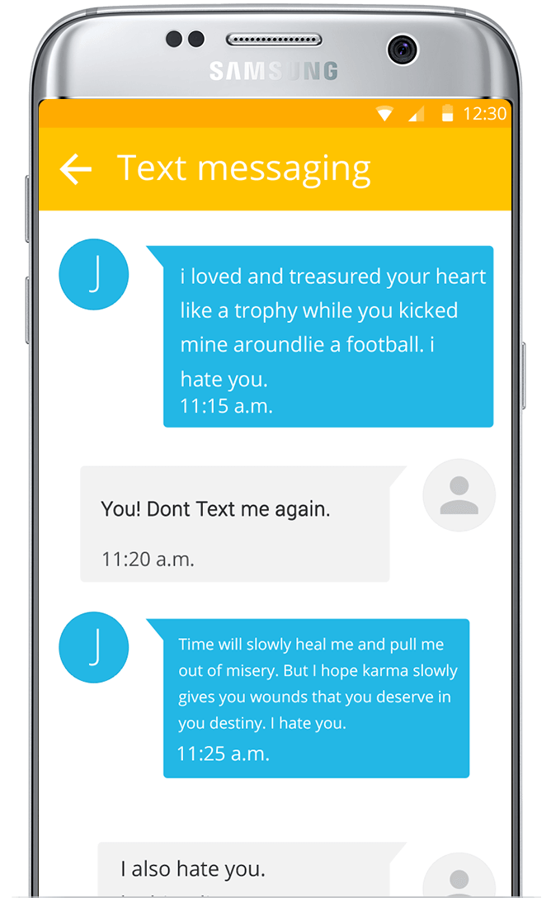
Tell the person to stop those messages sent to you, especially if they are mean and/or obscene.
Stop the Digital Misuse

Slide 22
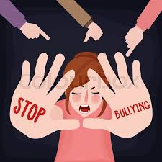

Don’t contribute to peer group “drama’ especially online.
Stop the Digital Misuse

Slide 23
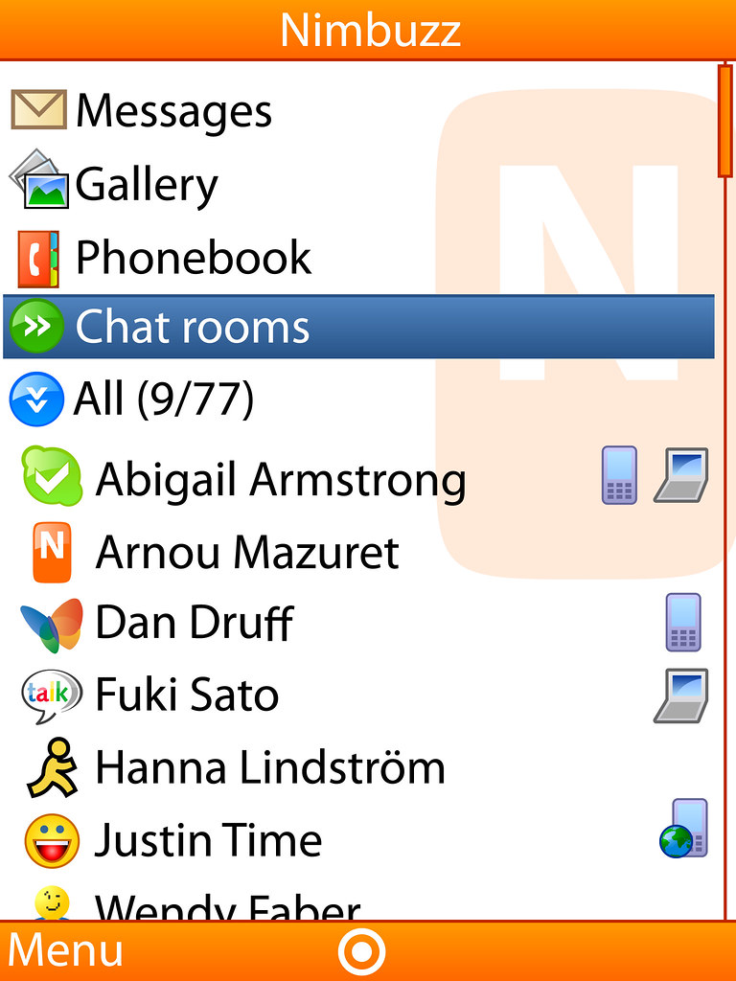
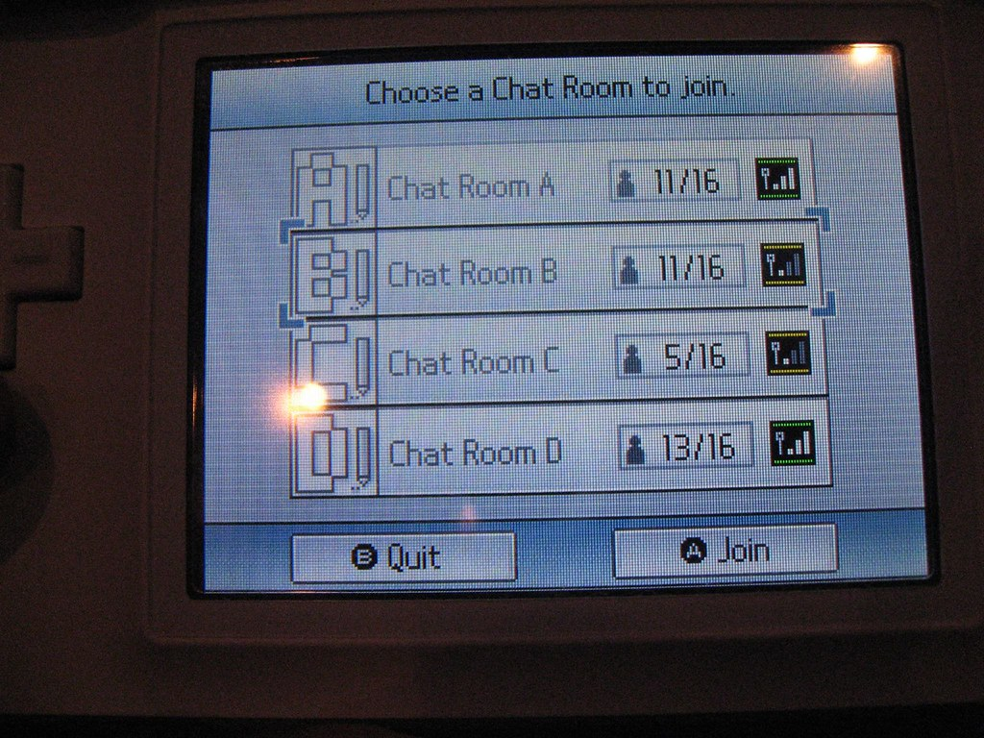
Stop the Digital Misuse
Leave chat rooms or online games when things turn ugly.

Slide 24

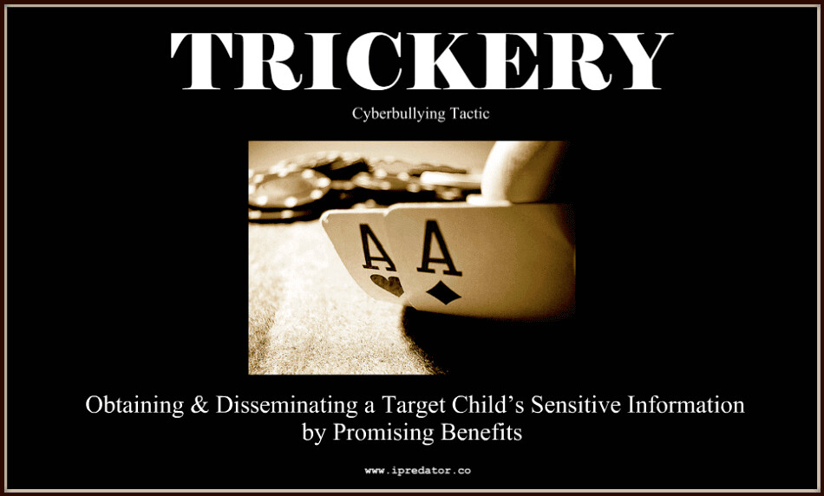
Don’t post online information that can be used to track you down or can be used against you.
Stop the Digital Misuse

Slide 25
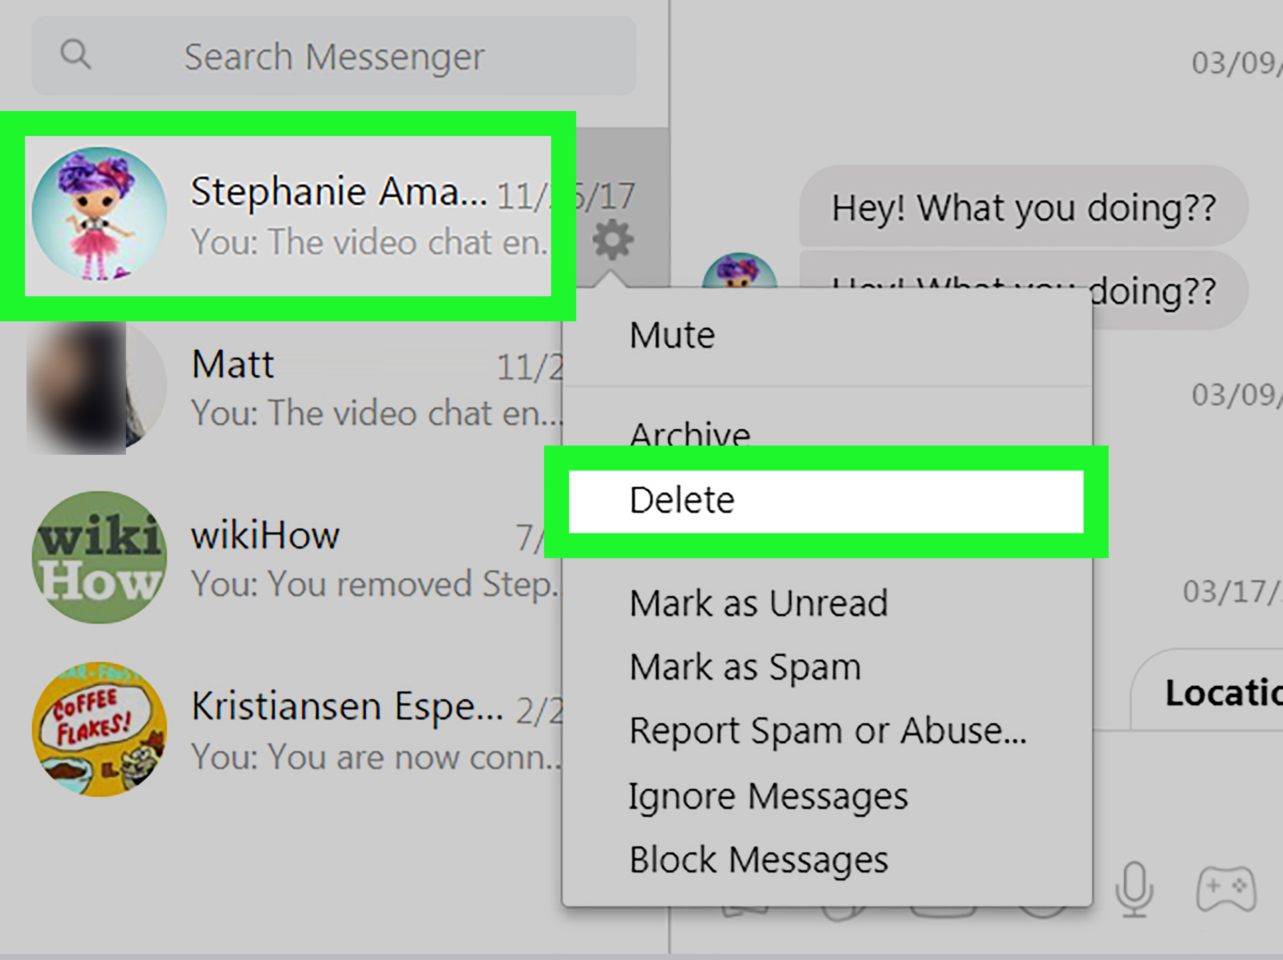
Don’t open messages or attachments from strangers.
Stop the Digital Misuse

Slide 26
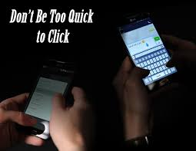
Don’t post anything you don’t want your parents to see now or your future children to see later.
Stop the Digital Misuse
Don’t respond to what is sent to you. Don’t retaliate. Bite your thumbs.

Slide 27
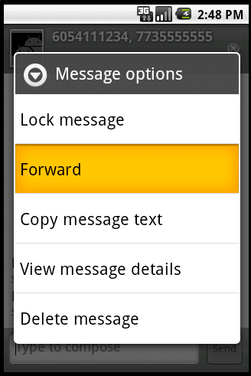

Stop the Digital Misuse
Don’t forward what is sent to you.
Don’t be a bully yourself
or allow others to be.

Slide 28
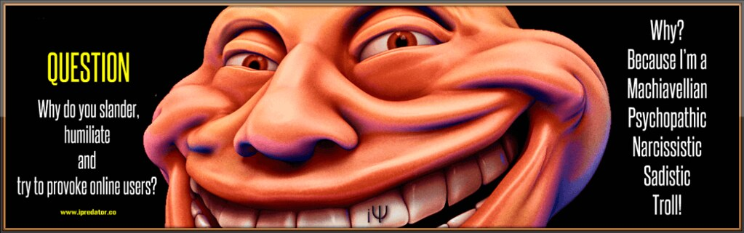
Stop the Digital Misuse
Don’t post mean comments or hateful rumors.
Don’t troll- provoke readers to get angry or fight back.

Slide 29
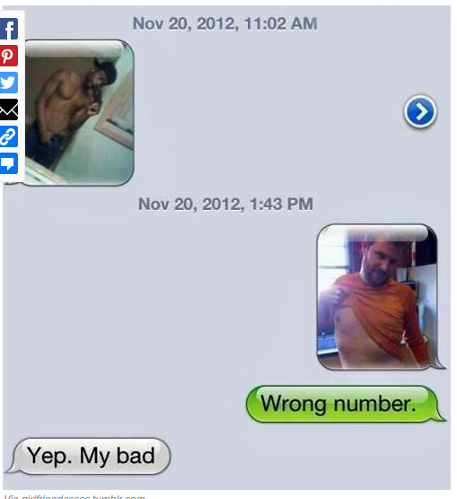
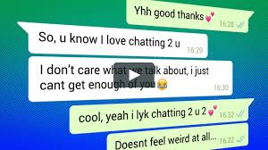
Stop the Digital Misuse
Save the evidence coming your way.
.

Slide 30
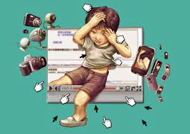
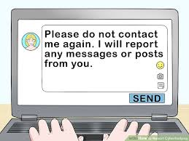
Stop the Digital Misuse
Block out the bad. Use privacy tools or preferences to keep your distance.
Tell an adult or trusted friend.

Slide 31

Stop the Digital Misuse
“Log off” and “log out” of someone’s life if you don’t like what is happening to you.
Think independently. You’re allowed.

Slide 32

Stop the Digital Misuse
Practice zero tolerance.
Don’t put up with anything that makes you feel uncomfortable.

